Slide 1
National Honor Society
Meeting #2
September 24, 2024

Slide 2
Agenda 9/24/23
-Guest Speaker- School Superintendent Ms. Rugani
-Induction Recap
-Panda Fundraiser Recap
-Local Scholarships
-Food Fair Recap
-Homecoming Parade Recap
-Points Sheet- NHS Expectations
-NHS Online Account
-Remind

Slide 3
Guest Speaker Denise Rugani
Superintendent of Liberty Union High School District

Slide 4
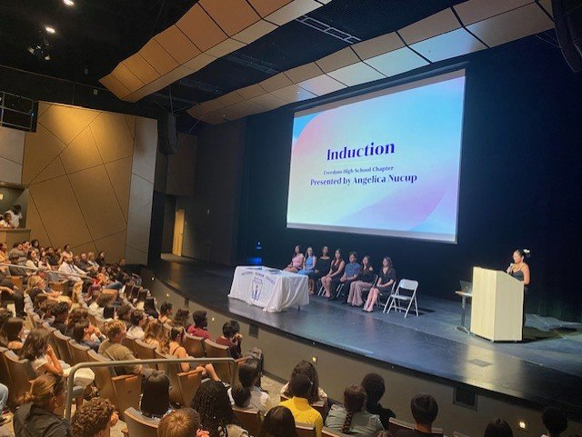
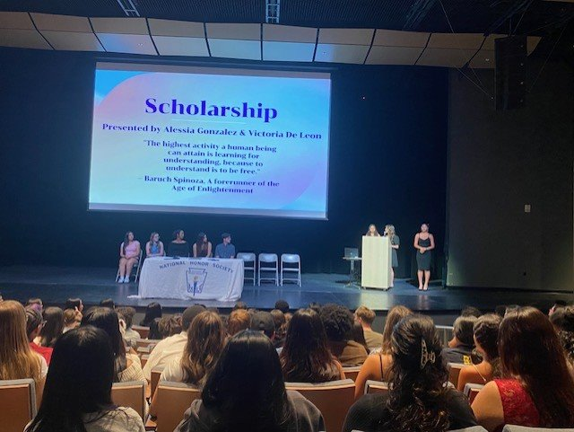
Induction recap in the PAC
-Over 290 guests in attendance
-109 new members inducted and recognized

Slide 5
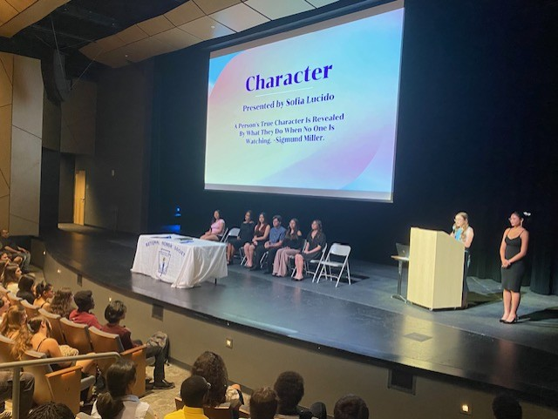
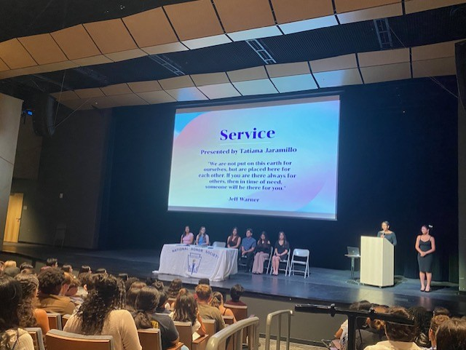
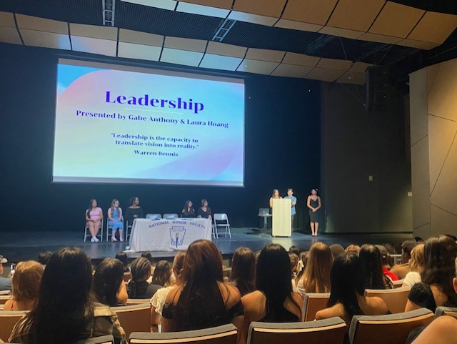
Induction recap in the PAC

Slide 6
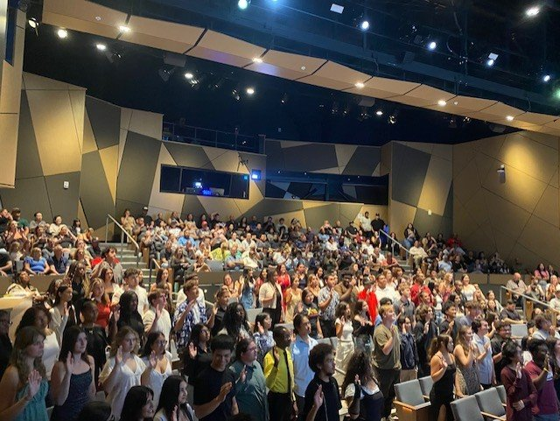
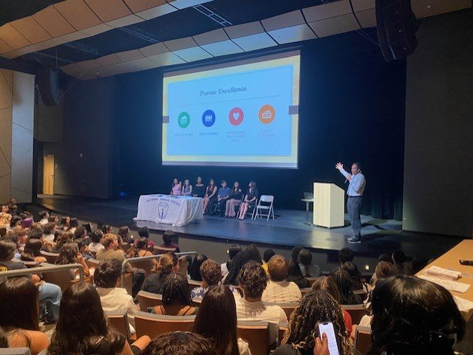
Induction recap in the PAC
-Guest speaker Principal Dr. Amaro
-Public speaking opportunities for executive cabinet members

Slide 7
Panda Express fundraiser updates
​
Amount Raised: $237.02
​
Goal for end of year: $1,000+ for scholarships for the class of 2025

Slide 8
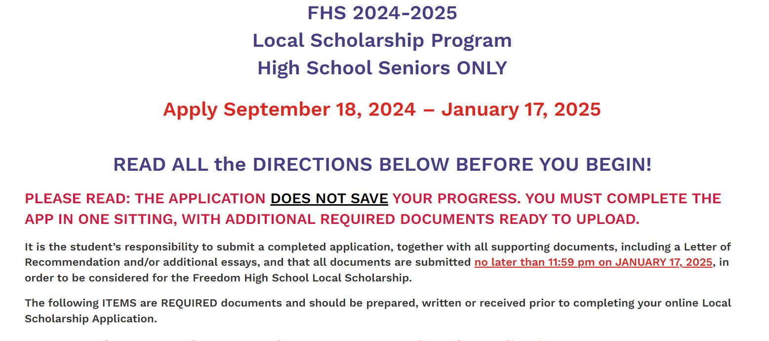
-Freedom High School students ONLY
-Local scholarship application (class of 2025)
-College and career center website

Slide 9
Food fair recap
Food sold: Taco Bell tacos
​
72 tacos+ water sold out in 20 minutes
​
Net profit: $200

Slide 10
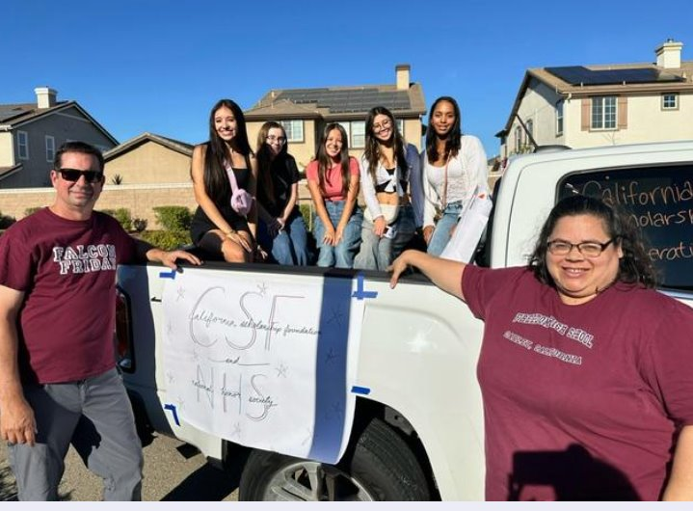
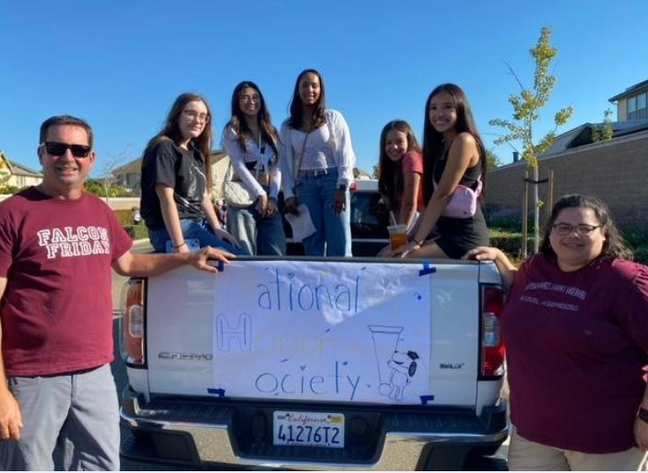
Homecoming parade recap
-5 students joined in the parade
-15+ students helped with posters

Slide 11
Point sheet/ Attendance/ Graduation Recognition
- https://www.luhsd.net/Page/16537 Forms​
Minimum 80% attendance to meetings is required to be an active member. ​
Completed Points Sheet for each semester.​
Qualified 4 total semesters. ​
20 Hours of community service, 10 hours each semester. ​
Fall 2024 Points Sheet due January 14th, 2024​
​

Slide 12
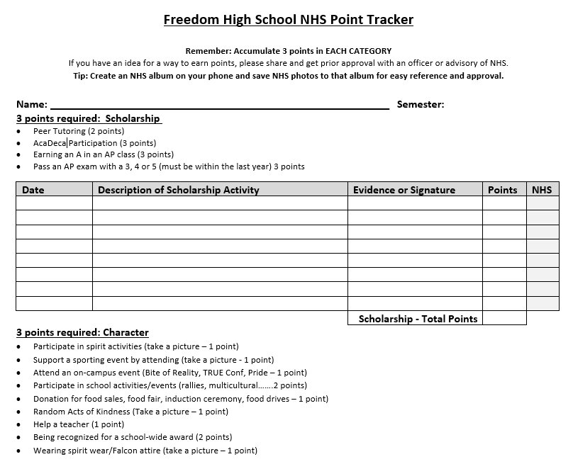

Slide 13
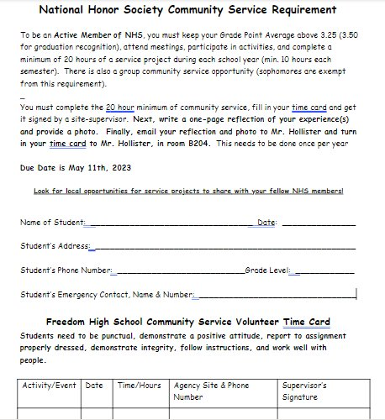

Slide 14
Join NHS online
- https://www.nhs.us/create-an-account/​
Check your school email, Mr. Hollister will send an email with details soon​
What are the benefits of creating a student account?​
Students with online accounts will receive regular updates about student program services, including new information about awards, resources such as #Futuready or the Career Exploration Series, project ideas from the National Student Project Database, updates on student conferences, and more. Senior members of NHS are required to have a verified profile to apply for the NHS Scholarship each October. Once verified, students will also earn a digital badge.​

Slide 15
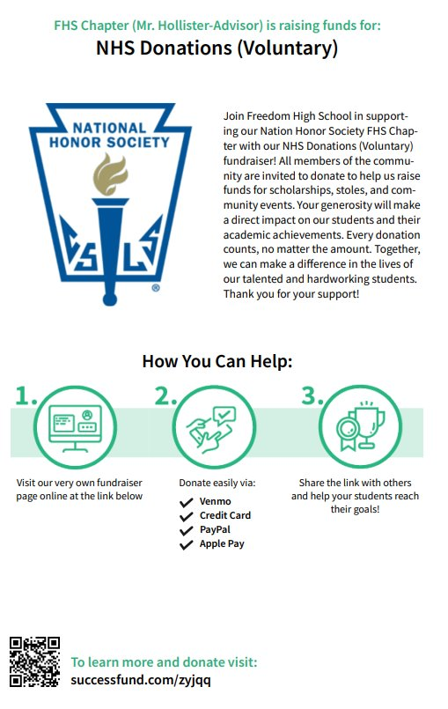
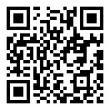
Online donations are now being accepted

Slide 16
Club information: Remind update
Check school issued email: Download the Outlook app and check your school email frequently​
Check club NHS Website frequently!​
STUDENTS MUST BE RESPONSIBLE FOR STAYING UP TO DATE ON ALL CLUB MEETINGS/ACTIVITIES​
Follow us on Remind for important information...​
Senior class code: nhs2425snr​
Junior class code: nhs2425jrs

