Slide 1
National Honors Society
Meeting #5 January 14, 2025

Slide 2
Agenda 1/14/25
01
02
03
04
05
06
School news
Account balance
Restaurant fundraiser
Upcoming events
Point sheet sign off
New point sheet handout

Slide 3
School news
Seniors
FHS Local scholarship application is due this Friday (January 17th)
Make sure to have your personal essay, letter of recommendation and academic resume ready to be uploaded. Some scholarships may require more than one letter of recommendation or essay.
You can find more information on the FHS website under college and career center, or by visiting the college and career center or by emailing Ms. Cartwright.

Slide 4
Account balance
Account balance as of January 9, 2025 = $2,500.03
Please not the suggested donation is $20 annually. This money goes towards graduation stoles and providing scholarships.
We need our balance over at least $3,000 to make our expenses.
Food sales week was a success! Thank you to everyone who volunteered and sold bags!

Slide 5
Restaurant fundraiser update
Our restaurant fundraiser was originally scheduled to be tomorrow, however due to scheduling issues with the restaurants we unfortunately have to move it.
We do not have a set date yet, but once we confirm a date and restaurant, we'll let you know and follow up with more details!
Please try to go! The money we make goes towards stoles and scholarships! Make sure to bring a friend and tell your families!

Slide 6
Point sheet attendance/ graduation recognition
Up next:
Fall semester community service and point sheets are due TODAY
Spring 2025 community service and point trackers due April 22, 2025
Cabinet and Mr. Hollister will be signing off today after the meeting. Please make sure to get them signed, turned in, and take a picture for documentation.

Slide 7
Club information
Make sure to sign up for the remind: nhs2425jrs & nhs2425snr
Check your school emails on outlook
Check the FHS school website frequently
Students are responsible for staying up to date on all club meetings/ activities!

Slide 8
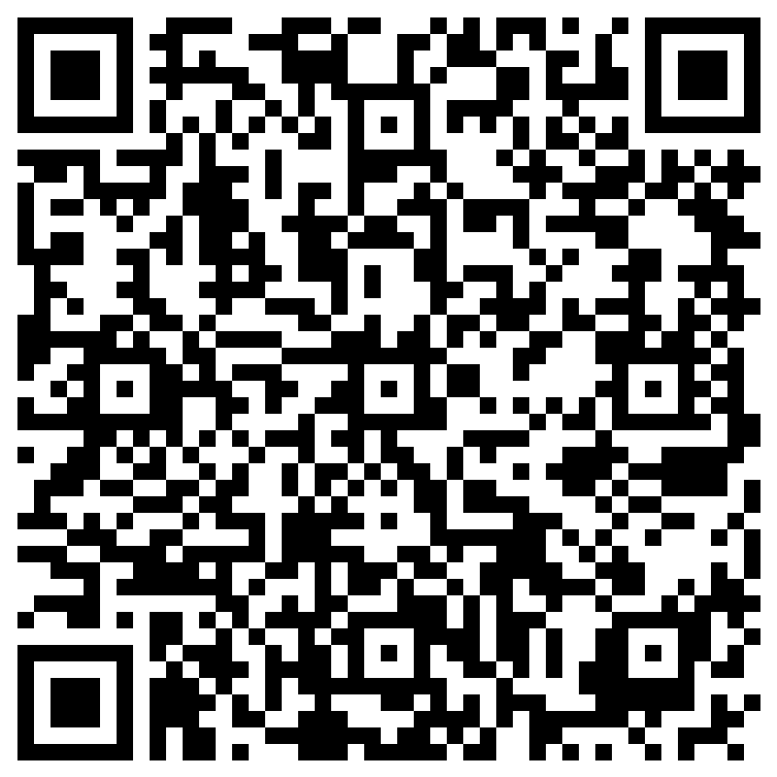
Sign-in!

