Slide 1
National Honors Society
Meeting #7 April 22, 2025

Slide 2
Agenda 4/22/25
01
02
03
CSF/NHS Awards Night May 13th
Sophomore NHS applications4/18-4/30
NHS scholarships
04
05
06
07
NHS Cabinet 25-26
Treasurers Report
Upcoming Dates of Interest
QR Code Sign-in

Slide 3
CSF/NHS Awards Night
(Tuesday May 13th)
NHS and CSF awards night will be held Tuesday, May 13! This is to commemorate our accomplishments and receive stoles. This event is only for Seniors who have completed ALL NHS graduation recognition requirements.

Slide 4
Spring Recruitment
4/15 - 4/30
Our recruitment campaign will began last week. Remember, for NHS, you only need to apply and be accepted one-time during high school. This campaign will be designed for current sophomores.​

Slide 5
2025-2026 Executive Cabinet
Congratulations to our next Executive Cabinet!
Name | Position
Leah Sutter | President
Mary Clarke | Vice-President
Yuliana Luna | Vice President
Dalila Hernandez | Secretary
Camila Robles | Secretary
Tori Tribble | Treasurer
Elie Vega | Treasurer
Araceli Navarro Sotelo | Historian

Slide 6
Scholarship update
NHS scholarships will be awarded to seniors who submitted their applications to the college and career center who checked the box that they were interested in the NHS scholarship.
We had 54 applications received!

Slide 7
Treasurers Report
Current Balance: $2,751.01 as of 4/16/25
Reminder that NHS accepts yearly donations! Please see point trackers for details
A donation of $20 is highly recommended as this goes towards stoles and scholarships!

Slide 8
Point trackers: Due Today
What do I need to turn in?
-Point trackers with 3 points in each category and signatures
-Completed community service sheet (minimum 10 hours) with signatures
Who do I turn this into?
-NHS executive cabinet or Mr. Hollister
Can I turn this in past April 26th?
-No, late papers will NOT count. The district and club needs the list of students who have completed all NHS requirements in time to prepare for graduation.

Slide 9
Point Trackers: Process
Once signed off by the cabinet members
Staple (top left)Point Tracker on top of community service log.
Take a picture of all documents for your record, additionally you may need this information for other opportunities (outside of NHS)
Turn in directly to Mr. Hollister

Slide 10
CSF/NHS Awards Night- May 13th Graduation June 7th
Upcoming Dates of Interest

Slide 11
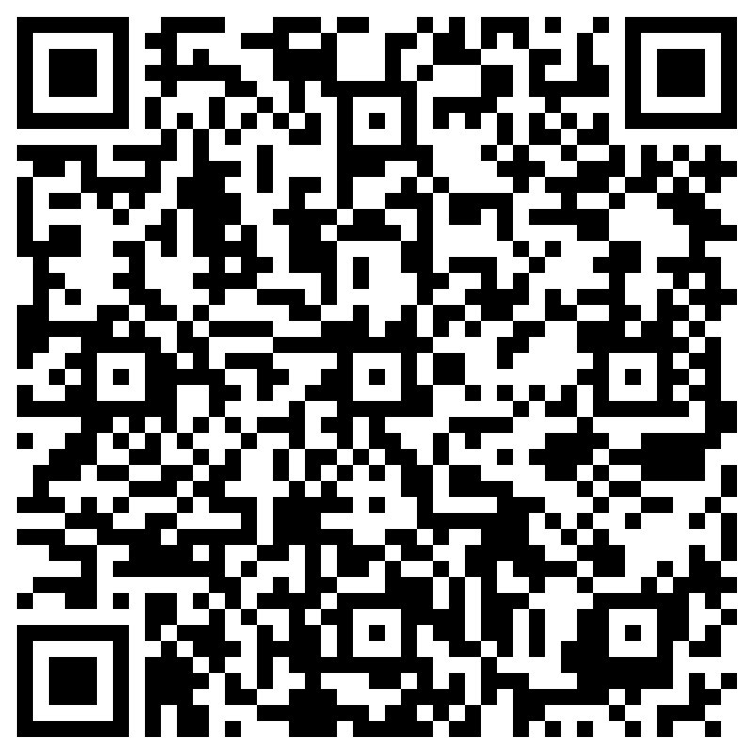
End of Meeting
Thank you for a wonderful year!

