Slide 1
Freedom Athletics Registration Instructions
2015-2016

Slide 2
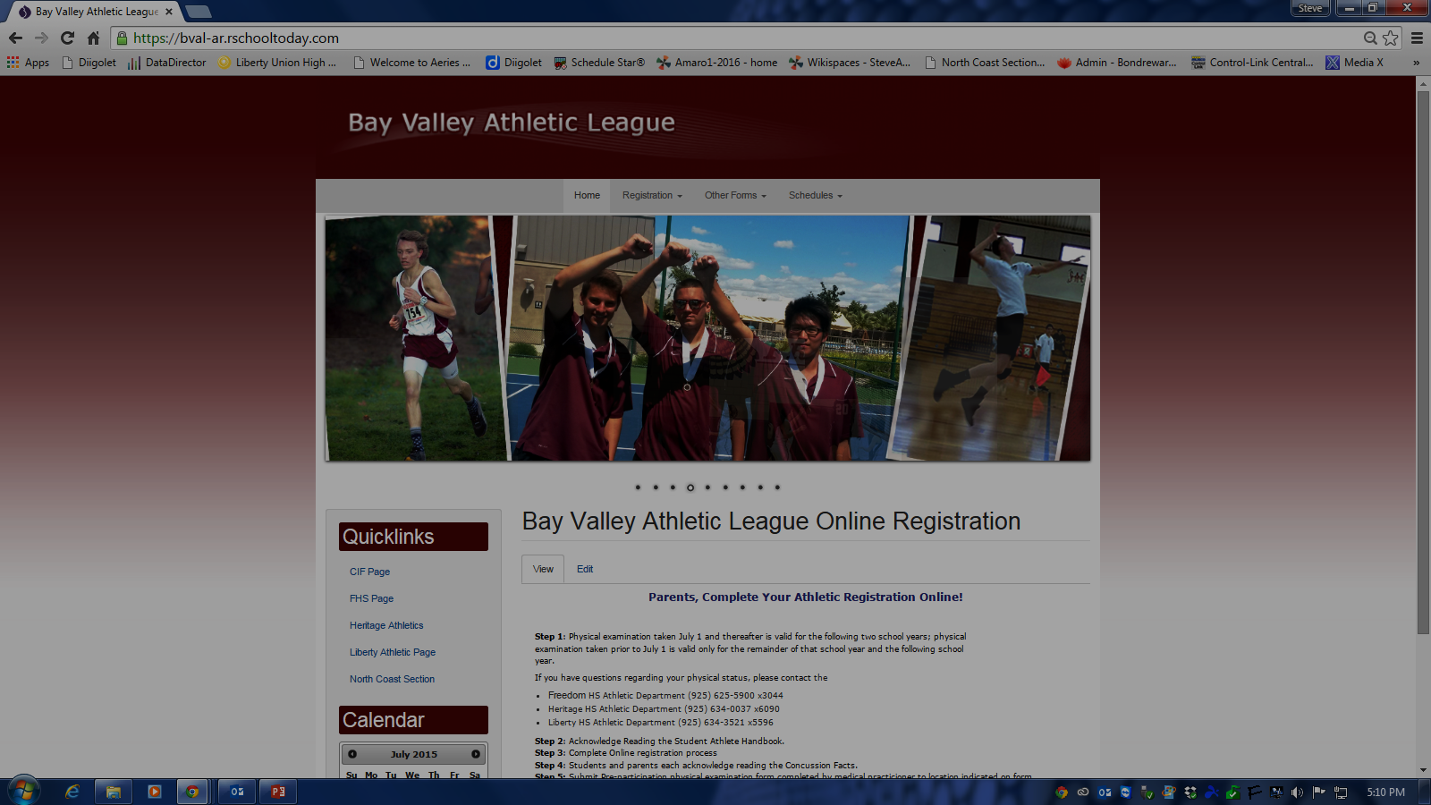
Freedom Online Registration
Go to the weblink for online registration.
Weblink is https://bval-ar.rschooltoday.com/
Select Freedom from the “Registration” box.
Create an account here to register online.

Slide 3
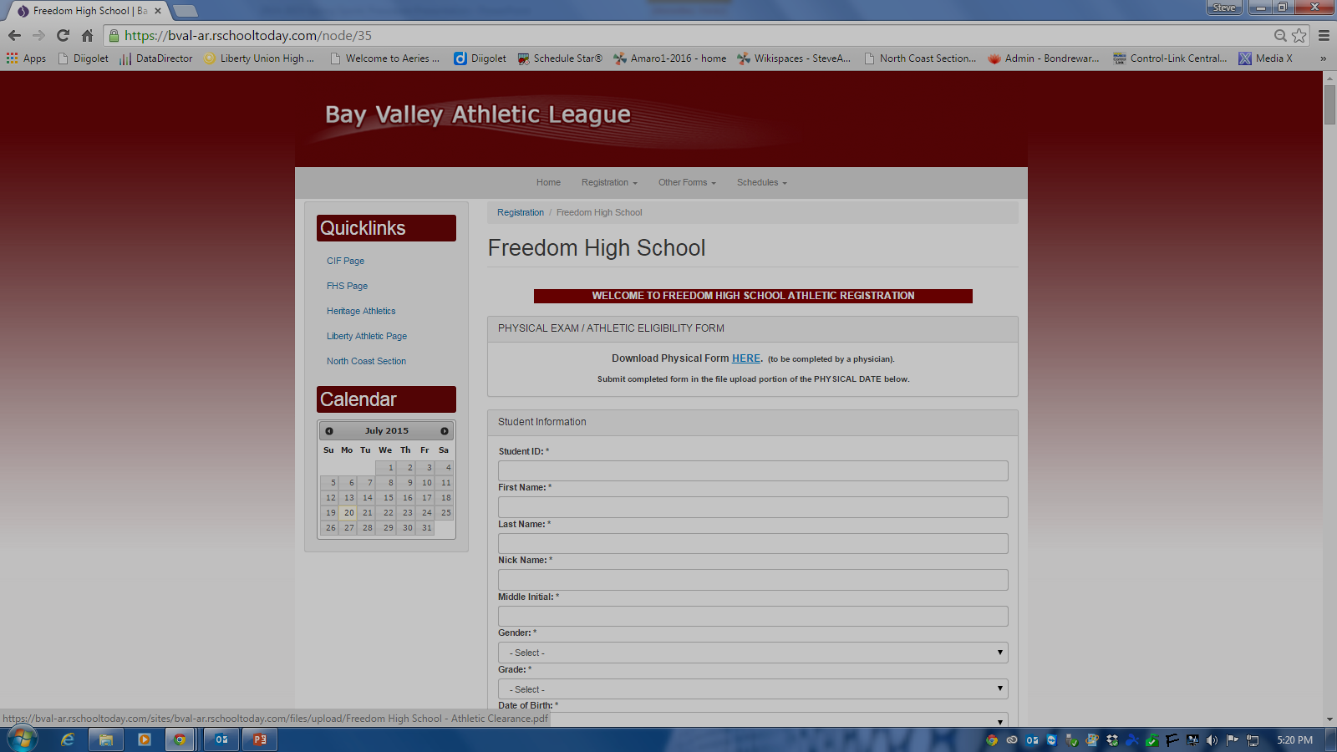
Freedom Online Registration
Print out and have a licensed physician sign the physical release form.
Fill out and digitally sign all other information!
Turn in physician form to H108 on campus.
That’s it! Welcome to Freedom Athletics!
***Grade & Residential Eligibility still must clear before participation and are verified by the athletic department.
You can also download all medical forms in hardcopy.

