Slide 1
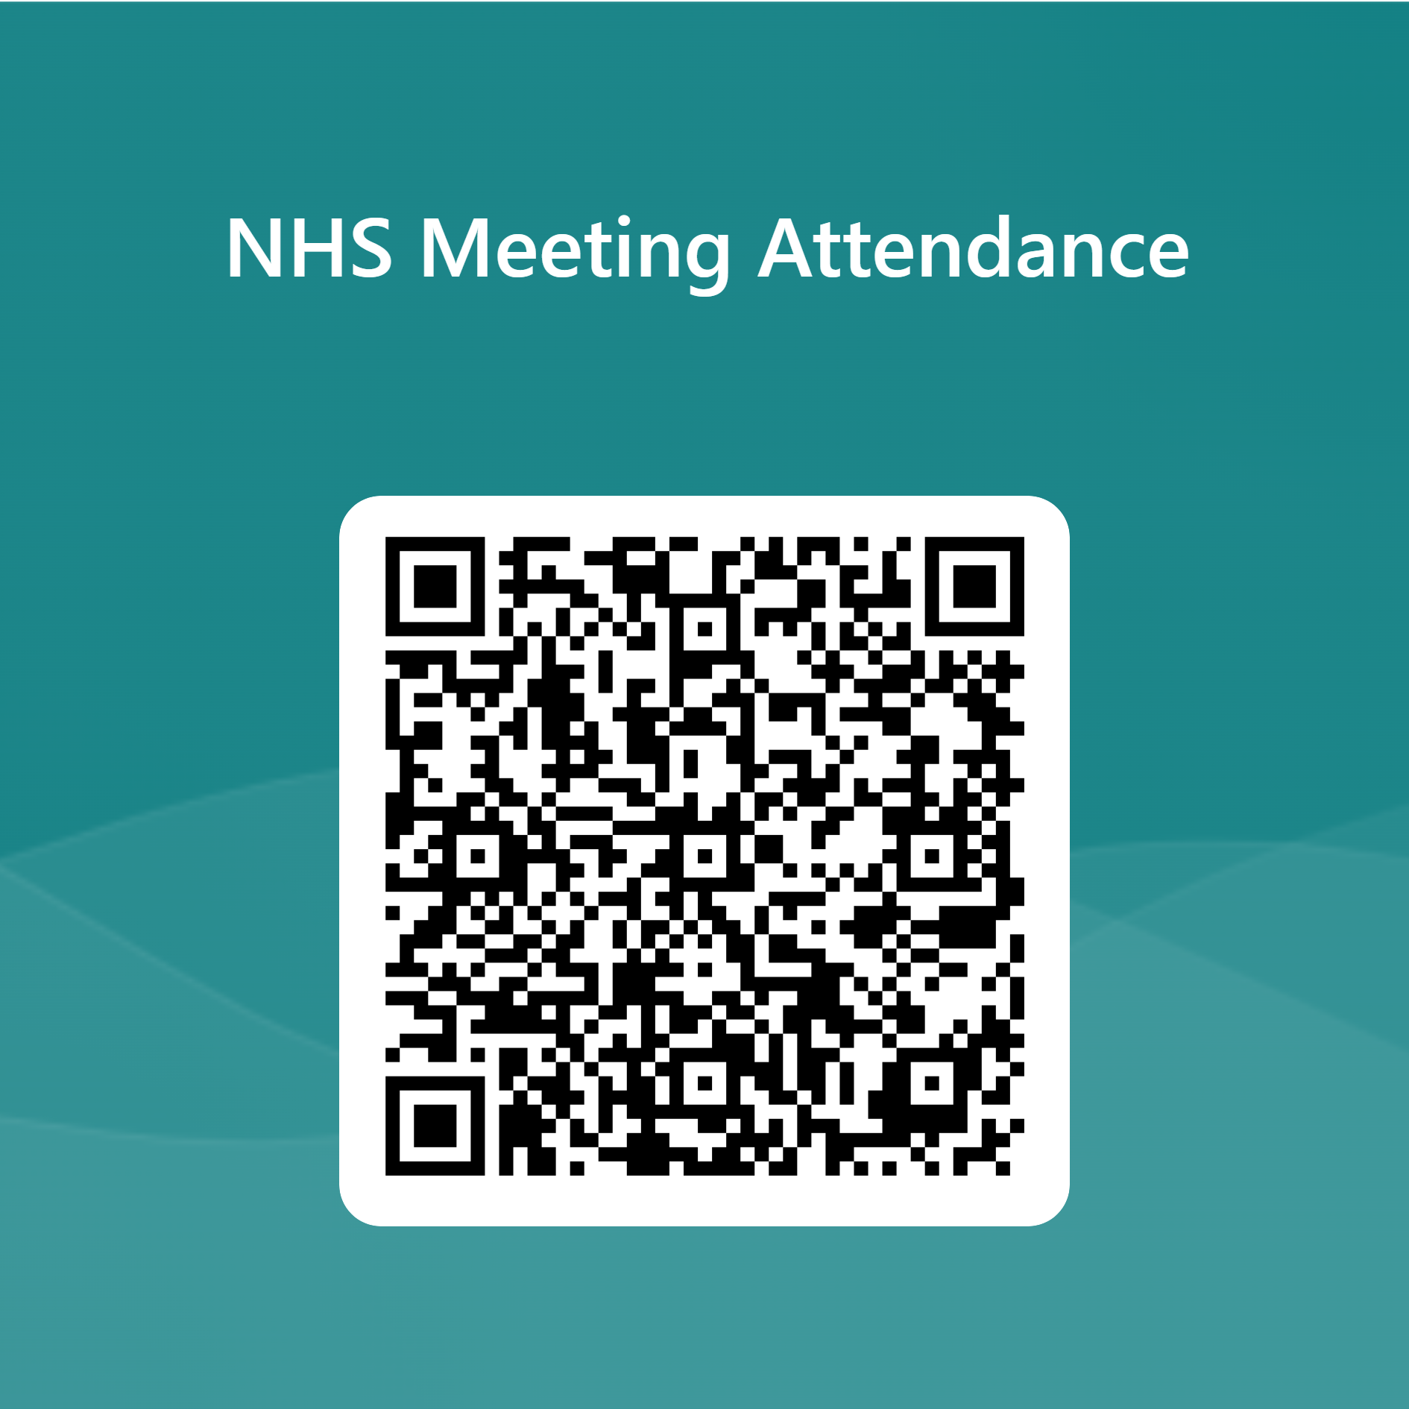
NATIONAL HONOR SOCIETY
Sign in using the QR code!
Meeting #7
April 4th, 2024

Slide 2
Agenda 4/4/2024
CSF/NHS Awards Night May 14th
Sophomore Applications for NHS Membership 4/17-5/5/2023
NHS Scholarships
NHS Cabinet 2023-2024
Treasurers Report
State Seal of Civic Engagement
Upcoming Dates of Interest + Falcon Fest
Start CSF Meeting

Slide 3
Awards Night/Induction
Tuesday, May 14th: NHS and CSF will be having our awards night. This is an opportunity for us to celebrate our accomplishments and receive our graduation stoles. Only for seniors who have completed all NHS graduation recognition requirements.

Slide 4
Spring Recruitment 4/15/24 -- 5/3/24
Our recruitment campaign will begin on Monday 4/15. Remember, for NHS, you only need to apply and be accepted one-time during high school. This campaign will be designed for current sophomores.

Slide 5
Scholarship Update
Class of 2024: NHS scholarships will be awarded for members who submitted applications to the career center in the fall and checked the box that they were interested in the NHS scholarship.
21 applications received (16 in 2023)

Slide 6
2024-2025 Officer Selection
Opportunity for candidates to speak Student voting will begin after the meeting, and conclude tomorrow (Friday) @ 1:45pm.
You must log into your school email to vote!
Name | Candidate
Criswell Brandon | Secretary
Fye,Skyler | Secretary
Mariam Hayath | Secretary
Anthony, Gabe | Vice President
Hoang,Hien | Vice President
Baarda, Grace | Treasurer
De Leon, Lane Victoria | Treasurer
Gonzalez, Alessia | Treasurer
Jaramillo, Tatiana | Historian
Lucido, Sofia | Historian
Martinez, Angelina | President
Nucup, Angelica | President

Slide 7
2024-2025 Officer Selection
How to vote? (juniors)
1) Log into MS Office 365 via your school account.
2) Access the link sent by Mr. Hollister in your Outlook email.
3) Complete the ballot and submit.
Deadline: 1:45pm tomorrow (Friday)

Slide 8
Treasurers Report
Current Balance $2,839.01
as of 4/3/2024
Reminder NHS is still accepting yearly donations, see point tracker for details
Please make donation ($20) if possible to the Student Store, Mrs. Watson.
This Photo by Unknown author is licensed under CC BY-SA.

Slide 9
Seal of Civic Engagement
Seniors…
Applications Due April 23rd!
What do I need to turn in?
Time-card with 20 verified community service hours.
Either a signed Statement of Character OR a letter of recommendation.
Capstone project (see application for instructions).
Who do I turn this in to?
Any Government or Economics teacher.
Any CSF or NHS advisor.
Can I turn this in past April 23rd?
No, the district needs the list of students who have completed the requirements for the Seal of Civic Engagement in time to prepare for graduation.

Slide 10
NHS Point Tracker
Due April 26th!
What do I need to turn in?
Point Tracker with completed categories (3 points) for Scholarship, Character, Service, and Leadership
Completed Community Service sheet (10 hours) with signatures.
Seniors only- 1 page written and printed out reflection on your NHS experience.
Who do I turn this in to?
Mr. Hollister B-204 on, or before April 26th
Can I turn this in past April 26th?
No, the district and club needs the list of students who have completed the requirements for NHS recognition in time to prepare for graduation.

Slide 11
Upcoming Dates
Seal of Civic Engagement Application/ Hours/Project
Due April 23rd
Falcon Fest April 26th
Community Service and Point Tracker
Due April 26th
CSF/NHS Awards Night May 14th

Slide 12
End of NHS Meeting...start of CSF meeting
Sign up
Sign up for remind: Text @ to 81010
Check
Check school issued email: Download the Outlook app
Website
Check School Website frequently!
Sign in here if you have not already done so.

