Slide 1
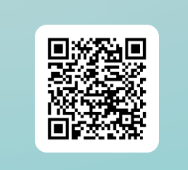
Be Sure to sign in
Meeting #4
December 2nd, 2024

Slide 2
NATIONAL HONOR SOCIETY
Meeting #4
November 10th, 2022

Slide 3
Agenda 12/2/2024
Food Fair Results
Food Sales Week
Account Balance
Points Sheet- (Sign-off)

Slide 4
Taco Bell
Q2 Food Sales Results 11/21/2024
$120 profit
Special thanks to all those who helped and a shout-out to...

Slide 5
Food Sales Donations- Deliver on 1/6/2025 to B-204
We are in need of donations and are collecting individually pre-packaged snacks that students are able to sell at school. Snacks may include items like individual bags of chips, Cheez-its, goldfish, cookies, fruit snacks, rice-crispy, popcorn. Single serving size is ideal, pre-packaged is a must.
Please drop them by my room, B-204, on Monday 1/6/2025
This is an efficient way to continue to raise money to support our goals toward student scholarships, stoles for recognition, and community engagement.

Slide 6
Food Sales Preparation-volunteers
1st week of 2nd semester January 6th to 10th NHS Food Sales week
3-7 Volunteers needed on Tuesday 1/7 AM at 7:30, to prepare the food sales bags.
20 Volunteers to sell the items in the bag during the week, and return the money by Friday at lunch. Pick up on Tuesday
This will count as points toward service and help the club raise funds for scholarships and community events.
Find a friend and come help out
Mr. Hollister will send a signup Genius before break

Slide 7
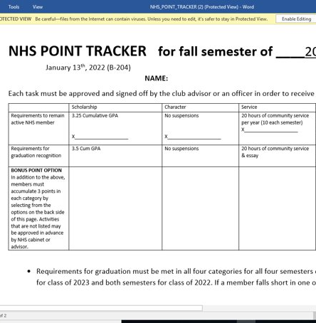
Point Sheet/ Attendance/Graduation Recognition
Sign-offs available today after the meeting.
Fall Semester Sheets Due
January 14th , 2025

Slide 8
Account Balance as of 12/2/2024
$2435.03
Please note the suggested donation is $20 annually. This money goes to buy the stoles and provide scholarships.
We will need the balance up over $3,000 to make our expenses..
To donate please being cash or check to the Student Store and let Ms. Watson know this is for NHS.
This Photo by Unknown Author is licensed under CC BY-NC-ND

Slide 9
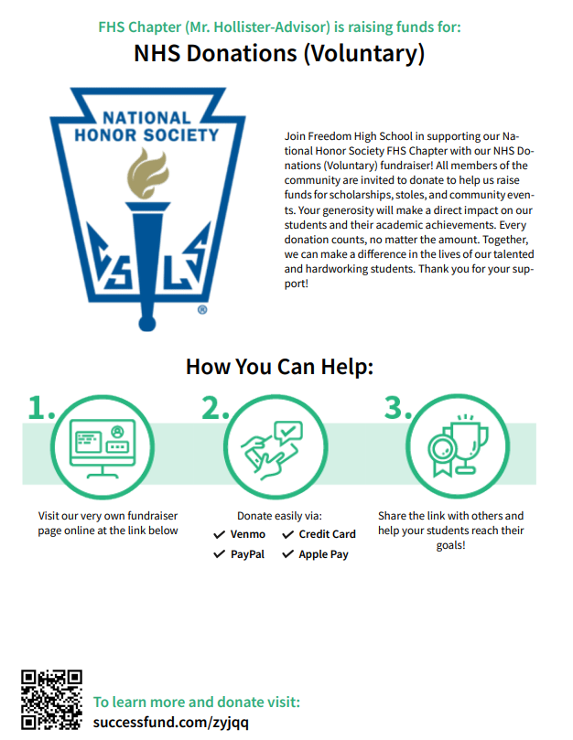

Slide 10
Club Information
Follow us on Remind for important information...
nhs2425jrs
nhs2425snr
Check school issued email: Download the Outlook app
Check School Website frequently!
STUDENTS MUST BE RESPONSIBLE FOR STAYING UP TO DATE ON ALL CLUB MEETINGS/ACTIVITIES

Slide 11
Club Information
Follow us on Remind for important information...
nhs2425jrs
nhs2425snr
Check school issued email: Download the Outlook app
Check School Website frequently!
STUDENTS MUST BE RESPONSIBLE FOR STAYING UP TO DATE ON ALL CLUB MEETINGS/ACTIVITIES

Slide 12
Be Sure to sign in
Meeting #4
December 2nd, 2024
Meeting Adjourned

