Slide 1
National Honor Society Meeting #7 March 11,2025

Slide 2
Agenda 3/11/25
01
CSF/NHS awards night
06
02
Point trackers and community service
10th grade applications for next year
07
03
NHS scholarships
State seal of civic engagement
08
04
Treasurers report
Upcoming dates of interest
09
05
Donations link
NHS cabinet 2025-2026 presentations

Slide 3
CSF/NHS Awards Night for Seniors
Wednesday, May 14th: NHS and CSF will be having our Honors night. This is an opportunity for us to celebrate our accomplishments and receive our graduation stoles.
Please note that only Seniors who have completed all NHS graduation recognition requirements will receive honors.

Slide 4
Our recruitment campaign for new members will begin on Monday 4/14. Remember, for NHS, you only need to apply and be accepted one-time during high school. This campaign is designed for current sophomores.
Spring Recruitment 4/14 - 4/30

Slide 5
Scholarship Update
Seniors: NHS scholarships will be awarded for members who submitted applications to the career center in the fall and checked the box that they were interested in the NHS scholarship. However, please note that we need to meet our fundraising goals to provide money for scholarships.

Slide 6
Treasurers Report
Current Balance $2,715.93
as of 3/10/2025
Reminder NHS is still accepting yearly donations, see point tracker for details.
Please try to support any way you can! Our budget goes towards stoles, scholarships, and community outreach.

Slide 7
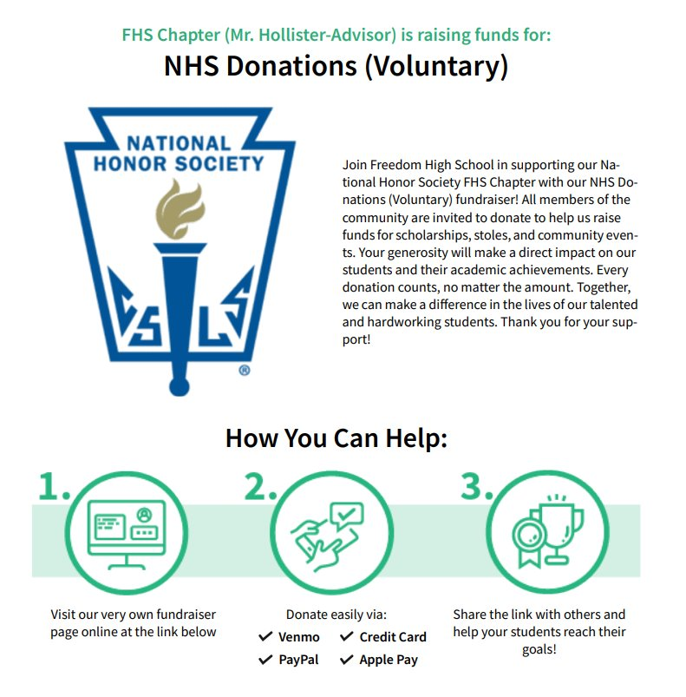
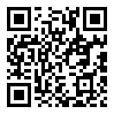
How to Donate?
Current Balance $2,715.93
as of 3/10/2025. Our goal is $3,500.
Use QR Code for link to online Success Fund Campaign

Slide 8
Point Trackers and Community Service
What do I need to turn in?
Who do I turn these forms into?
Can I turn in these forms after April 22nd?
Point Tracker with completed categories (3 points) for Scholarship, Character, Service, and Leadership ​
Completed Community Service sheet (10 hours) with signatures.​
Seniors only- 1 page written and printed out reflection on your NHS experience. ​
Turn into Mr. Hollister (B204) on or before April 22nd.
No, there will be no late exceptions. the district and club needs the list of students who have completed the requirements for NHS recognition in time to prepare for graduation.

Slide 9
State Seal of Civic Engagement- For Seniors application due April 23rd
What do I need to turn in?
Who do I turn these forms into?
Can I turn in these forms after April 23rd?
Timecard with 20 verified community service hours
Either a signed statement of character or a letter of recommendation
Capstone project (see application for details)
Turn into any Government or Economics teacher
Any NHS or CSF advisor
No, there will be no late exceptions. the district and club needs the list of students who have completed the requirements for NHS recognition in time to prepare for graduation.

Slide 10
Upcoming Dates
Due April 22nd
Community Service and Point Trackers due
Due April 23rd
Seal of Civic Engagement application/ hours/ project due
May 14th
CSF/NHS Awards Night

Slide 11
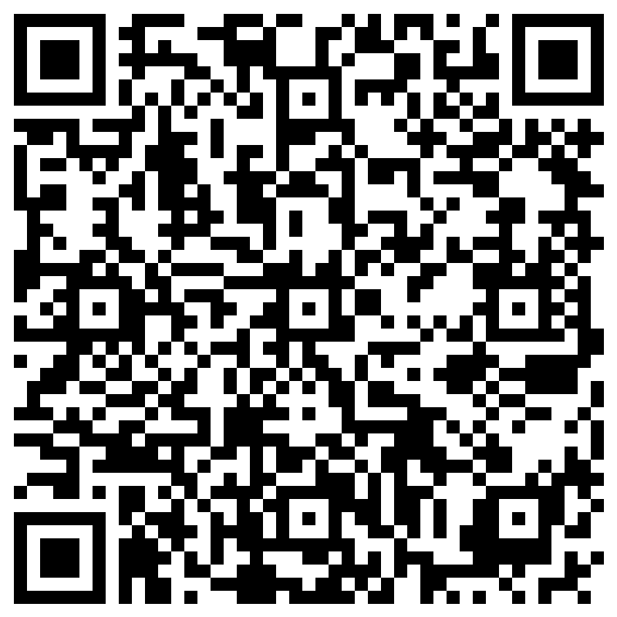
End of Meeting Attendance

Slide 12
How to vote
1.Login to your Microsoft 365 via your school account 2. Access the link sent by Mr. Hollister in your Outlook email 3. Complete the ballot and submit
2025-2026 Officer voting
Deadline: 3:30pm on Thursday

Slide 13
Opportunities for candidates to speak
Student name | Nomination
Araceli Navarro Sotelo | Historian
Dalila Hernandez | Secretary
Camila Robles | Secretary
Mary Clarke | Vice-President
Yuliana Luna | Vice-President
Yexly Medel | Vice-President
Tori Tribble | Treasurer
Elie Vega | Treasurer
Jase Saob | President
Leah Sutter | President
Jaylene Valencia | President
Student voting will begin after the meeting and will conclude on Thursday at 3:30pm. You must login to your school email to vote!

