Slide 1
Chemical Reaction

Slide 2

What is a chemical reaction?
A process in which substances undergo chemical changes to form a new substance.
Common chemical reactions in real life:
  Baking bread or cake, cooking.
  plant grow
  digestion
  Leaves and plants decay
  Others?

Slide 3
Signs of chemical reaction
Temperature change & production of light/flame
Production of a gas (fizzing, bubbling)
Color change
Formation of a precipitate (solid particle)

Slide 4
Representing Chemical Reaction?
Chemical Equation,
shorthand way of writing or representing a chemical reaction
Uses symbols to show the relationship between reactants and products.

Slide 5
Chemical Equations format
Starting Substances that participate in reaction
“Yields”
(Makes)
A substance that forms

Slide 6
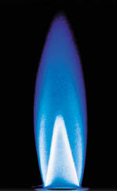
Chemical Equation example
Example Equation1
Methane gas burning/ combustion
CH₄
yields
REACTANTS
PRODUCTS

Slide 7
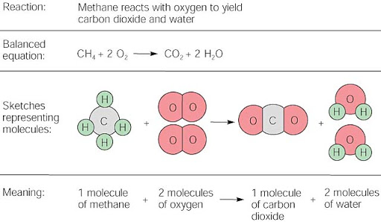
Modeling Chemical Equation

Slide 8
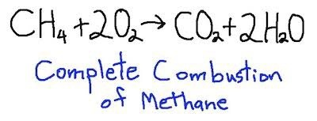
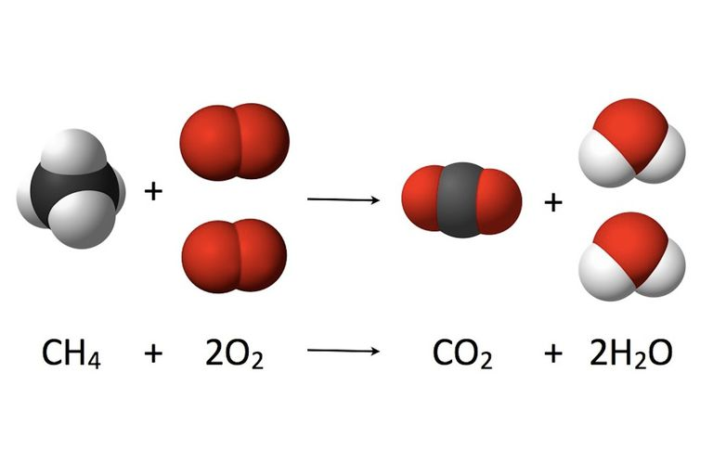

Slide 9
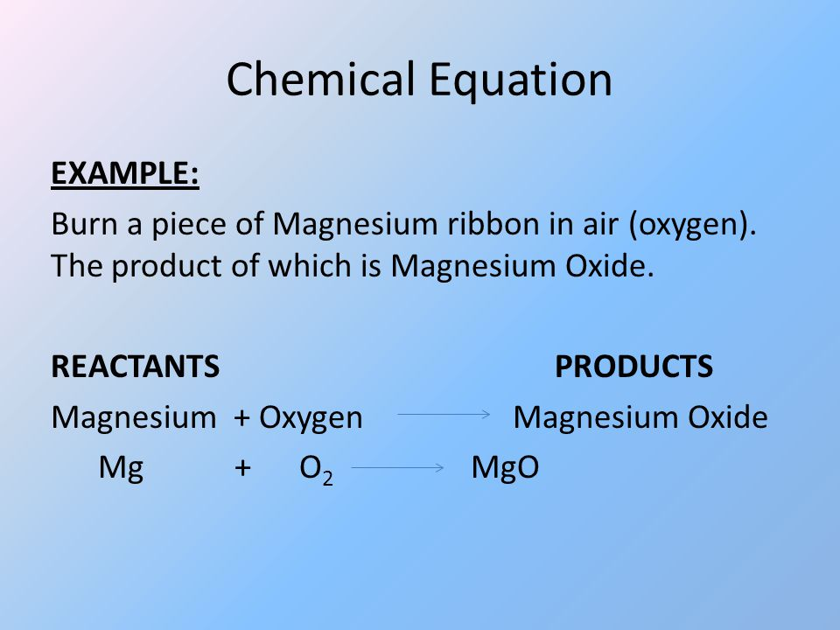
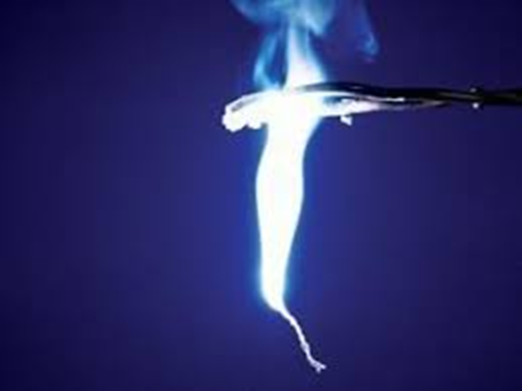
Example 2: Burning magnesium

Slide 10
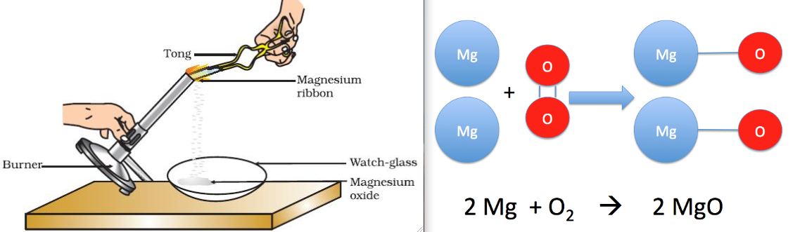
Burning magnesium

Slide 11
Symbols used in Chemical Equations
Symbols | Meaning
+ | Separate two or more reactants or products
 | Yields , separate reactants from products
(s) | Solid state
(l) | Liquid
(g) | Gas
(aq) | Aqueous solution, dissolved in water
 | Heat is supplied to the reaction
Pt | Indicates the use of catalyst (ex. platinum)

Slide 12
What happens in a Chemical Reaction?
Formation and breaking of bonds due to movement of electrons between atoms. (ionic or covalent)
Changes in energy
Energy is either released or/ and absorbed

Slide 13
Chemical Energy
Chemical compounds store energy in the bonds between their atoms. This is known as chemical energy.
The energy that is stored in the form of chemical bonds.

Slide 14
What happens to the energy during chemical reaction?
Chemical energy may change form.
However, the total amount of energy is the same before and after the reaction.
The amount of energy in the reactant is the same as the amount of energy in the product.
Energy absorbed = energy released.
This is known as the

Slide 15
Law of conservation of Energy
Law of Conservation of Energy
“Energy is neither created nor destroyed but is transformed from one form to another.”

Slide 16
Results of chemical reaction
1. Formation of bonds
2. Breaking of bonds
When new bond is formed, energy is released
Example: In burning gasoline, energy is released as heat or light
Bonds break in chemical reaction. Breaking bonds requires energy
Example: energy is needed to break bonds of atoms in isooctane (gasoline) and oxygen. A spark from spark plugs provides the energy to breaks these bonds.

Slide 17
Activation Energy
The minimum energy that colliding particles (reactants) must have in order to react.
It is a barrier that reactants (hump) must cross to be converted to product.

Slide 18
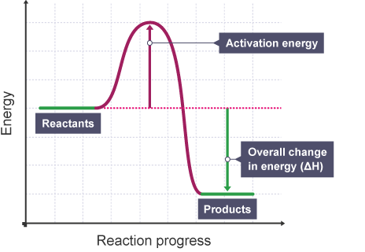
Activation Energy

Slide 19
Heat of Reactions
ENDOTHERMIC
Energy is absorbed by the reaction. (system)
The surrounding becomes cold but not necessarily.
EXOTHERMIC
Energy is released by the reaction.
The surrounding usually becomes warm but not necessarily

Slide 20
Checking for understanding1
1. What is the difference between endothermic and exothermic reaction?
2. Based from our previous experiment, give an example of an exothermic and endothermic reaction. Why?

Slide 21
Balancing chemical Equation

Slide 22
Understanding Chemical Formulas
Recall that the numbers at the bottom of a formula tell you how many atoms there are in that compound.
KCl₃
1 potassium
3 chlorine

Slide 23
Understanding Chemical Formulas
Sometimes formulas have parentheses. When you encounter these, just multiply what is inside the parentheses by the number outside the parentheses.
V₃(PO₄)₅
3 vanadium
20 oxygen
(4 x 5 = 20)
5 phosphorus
(1 x 5 = 5)

Slide 24
Understanding Chemical Formulas
If you have a number in front of a chemical formula, this indicates the number of molecules you have. Multiply the amount for each element by the number in front.
3 Al₂(SO₄)₃
6 Aluminum
(3 x 2 = 6)
9 Sulfur
(1 x 3x3 = 9)
36 Oxygen
(4 x 3 x3= 36)

Slide 25
Balancing Equations
REACTANTS
C : 1
H : 4
O: 2
PRODUCTS
C : 1
H : 2
O : 3
The number of atoms on the reactants side don’t equal the number on the products side.
Since we can’t make or destroy atoms, we must “balance” the equation.

Slide 26
Law of Conservation of Mass
“Mass is neither created nor destroyed but it just transformed from one form to another. ” ( rearrangement of atoms)
Mass of substances before and after the reaction is the same
Number of atoms before should equal number of atoms after the reaction

Slide 27
How do you balance a chemical equation:
1. Use coefficients: numbers placed in front of reactants and products to indicate their amount.
2. List the number of each element on both sides of the equation and write the number of atoms before and after the reaction. The number of atoms in the reactants should equal to the number of atoms in the product. If not, place a coefficient in front of the formula.

Slide 28
Continue:
3. When coefficient is placed, multiply the subscripts by the coefficient to determine the number of atoms on both sides. Then adjust the coefficients until the number of atoms is the same in the reactant and product.
Often, it is best to balance oxygen and hydrogen last. Polyatomic ions are such as SO₄⁻² is taken as one unit to make balancing easier.

Slide 29
Notes about Balancing Equations.
1. You can only balance an equation by putting coefficients in front of the compounds in the equation.
2. if there is No coefficients in front of the formula means, it is 1
3. You CANNOT change the formulas of the compound.
4. You CANNOT change the subscript in the chemical formula
5. Reduce the coefficients to the lowest terms/ numbers if there is a common denominator

Slide 30
Balancing Equations
2
2
We are going to add molecules to each side until both sides have the same number of atoms of each element.
REACTANTS
C : 1
H : 4
O: 2
PRODUCTS
C : 1
H : 2
O : 3
4
4
4
Now it’s balanced!

Slide 31
Balancing Equations Practice
2
2
REACTANTS:
  Mg: 1
  O: 2
PRODUCTS:
  Mg: 1
  O: 1
2
2
2
Now it’s balanced!

Slide 32
Balancing Equations Practice
REACTANTS:
  N: 1
  H: 4
  Cl: 1
PRODUCTS:
  N: 1
  H: 4
  Cl: 1
It’s already balanced! You don’t need to do anything to it.

Slide 33
Balancing Equations Practice
2
2
REACTANTS:
  H: 2
  O: 2
PRODUCTS:
  H: 2
  O: 3
4
4
4
4
Now it’s balanced!

Slide 34
Balancing Equations Practice
2
2
REACTANTS:
  Na: 1
  Cl: 2
PRODUCTS:
  Na: 1
  Cl: 1
2
2
2
Now it’s balanced!

Slide 35
Now it’s your turn to try…
Practice:
How many atoms of each element are in each of the following chemical formula?
1. 2KBrO₃ K ____Br __ O __
2. Ca₃( PO₄)₂ Ca ____ P__ O ____
3. 4( NH₄)₂S₂O₈ N___ H ___ S ___O ___

Slide 36
Now it’s your turn to try…
Practice:
How many atoms of each element are in each of the following chemical formula?
1.2KBrO₃ K , Br ___O ____
K 2 , Br 2 O 6
2. Ca₃( PO₄)₂ Ca __ P __ O __
Ca 3 P 2 O 8
3. 4( NH₄)₂S₂O₈ N __ H __ S __ O __
N 8 H 32 S 8 O 32

Slide 37
II. Balance the following equation
__ P₄ + __ O₂ _____ P₂O₃
2. __HgO __Hg + __O₂
3. __NaF + __ Br₂ ___ NaBr + ___ F₂
4. __SO₂ + ___Li₂Se ___ SSe₂ + ___ Li₂O

Slide 38
Types of Reactions
Synthesis (combination)
Decomposition
Single Replacement/displacement
Double Replacement/displacement
Combustion reaction

Slide 39
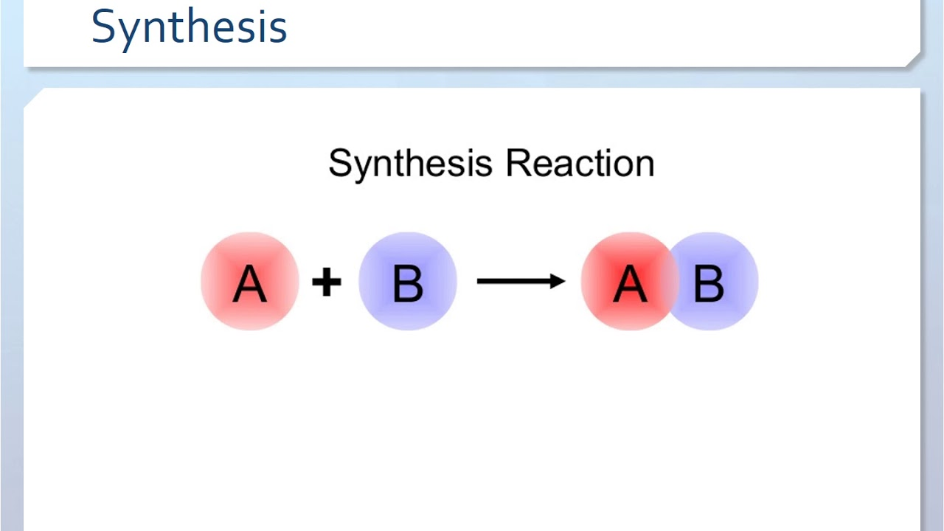
Synthesis Reaction
Two or more elements combine to form a new compound.
There’s only ONE PRODUCT in this type of reaction.
FORMAT

Slide 40
Example 2: Burning magnesium

Slide 41
Burning magnesium model

Slide 42
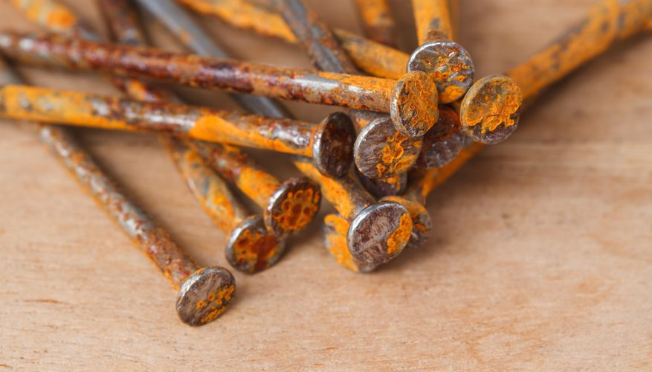
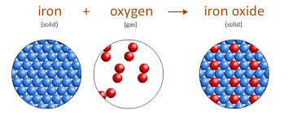
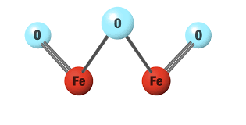
Synthesis reaction example
Rusting of Iron (Fe)
Iron metal reacts with oxygen to form iron(III) oxide (rust).
Sample equation:

Slide 43
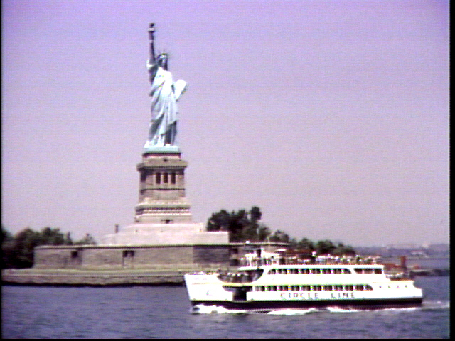
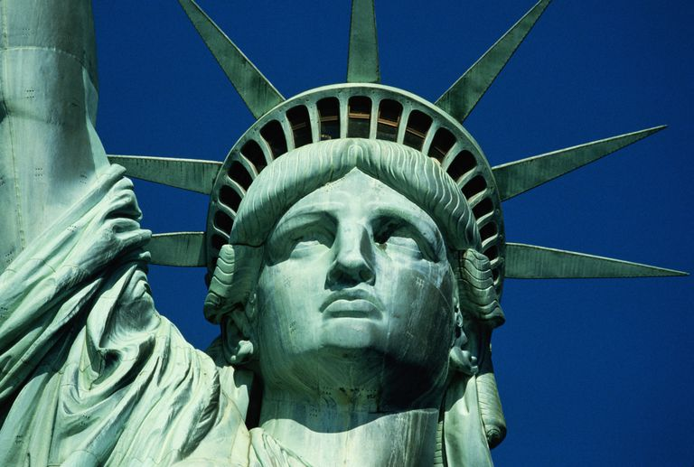
Synthesis Reactions
The copper on the Statue of Liberty reacts with oxygen to form green copper (II) oxide.
Sample equation:

Slide 44
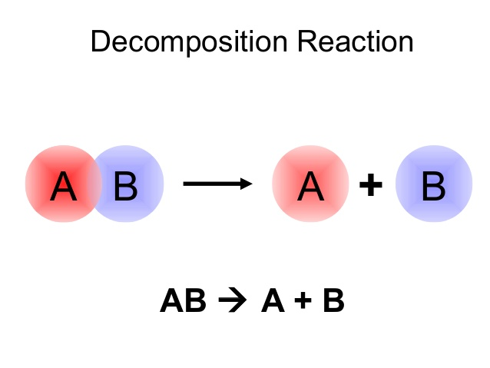
Decomposition Reaction
A single compound break apart to
produce two or more elements.
In this type of reaction there is only ONE REACTANT.
Format :

Slide 45
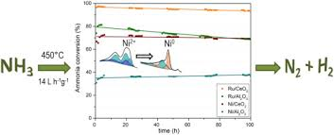
Decomposition of Ammonia gas sample equation:
NH₃ N₂ + H₂

Slide 46
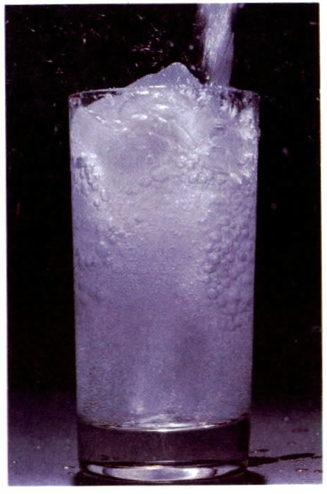
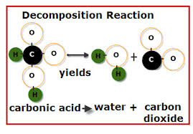
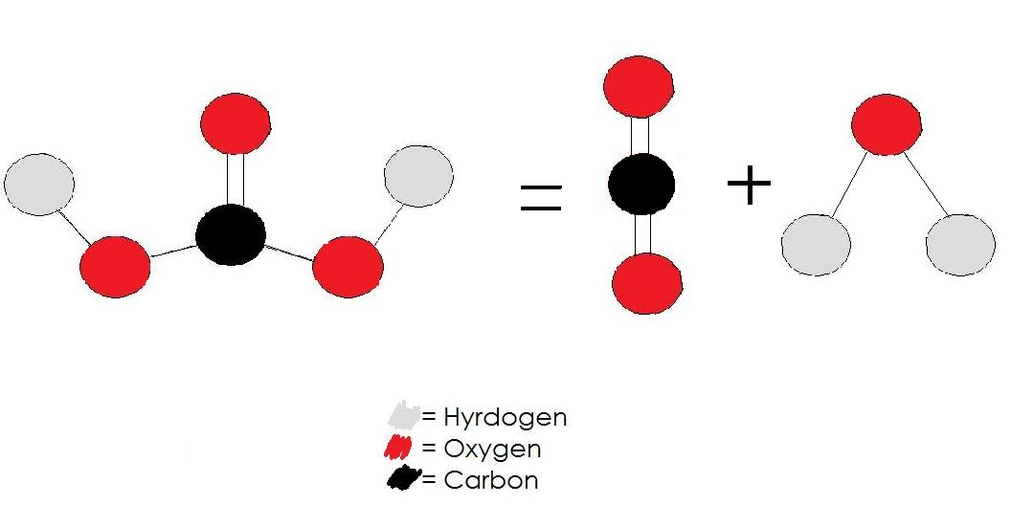
Decomposition Reactions
Carbonic acid (soda) decomposes to form water and carbon dioxide.
Sample equation:

Slide 47
Checking for understanding 2
1. How many reactants and products are in the decomposition reaction? Give an example equation
2. How many reactants and product are in synthesis reaction? Give an example equation

Slide 48
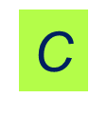
Single Replacement Reactions
One element replaces a similar element in a compound.
In this type of reaction, there’s an element and
a compound on each side of the equation.
Format
Metal
C
nonmetal
C
C

Slide 49
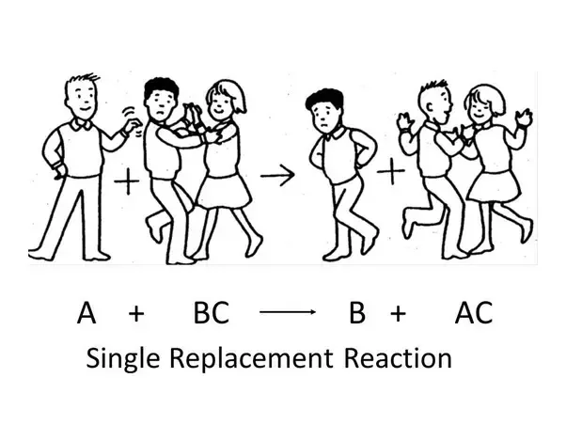
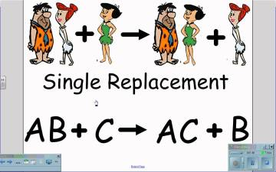
Swap spot reaction
Metal
Nonmetal

Slide 50

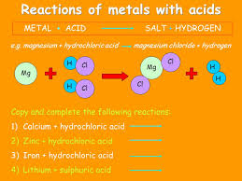
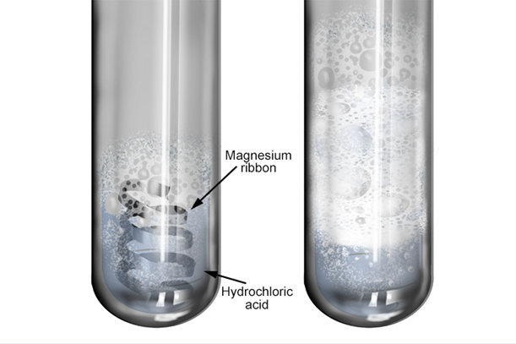
Single Replacement/ displacement
Reaction of a alkaline earth or alkali metal and an acid yields a salt and hydrogen gas.
Element
Compound
Element

Slide 51
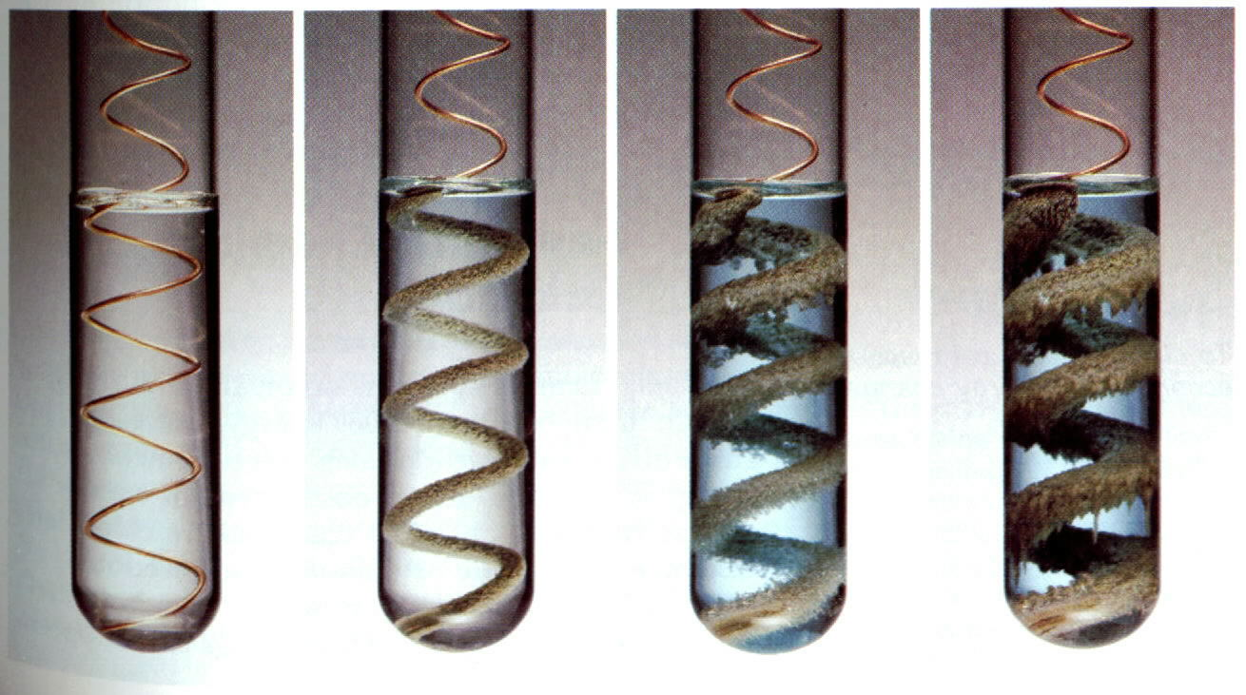
Single Replacement/displacement
Copper wire reacts with silver nitrate solution to form silver metal and a copper nitrate solution.
Element
Compound
Compound
Element

Slide 52
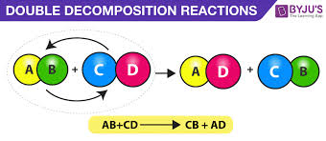
Double-Replacement/Displacement
The ions (metal to nonmetal) of two compounds exchange places to form two new compounds.
In this type of reaction, there will be two compounds on each side of the equation.

Slide 53
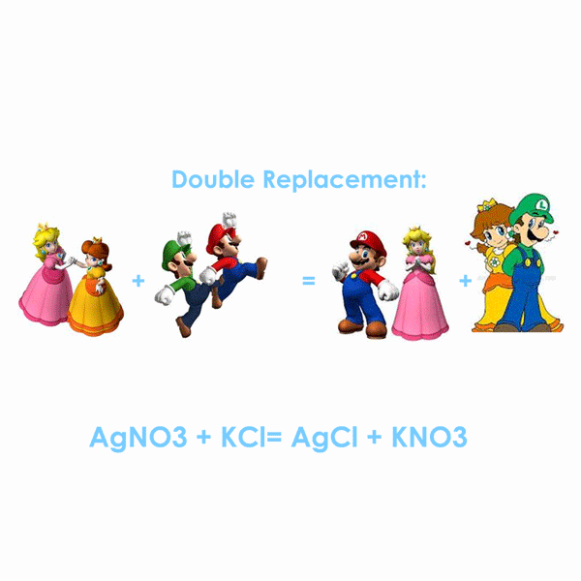
Exchange Partners

Slide 54
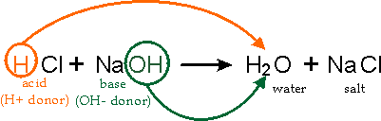
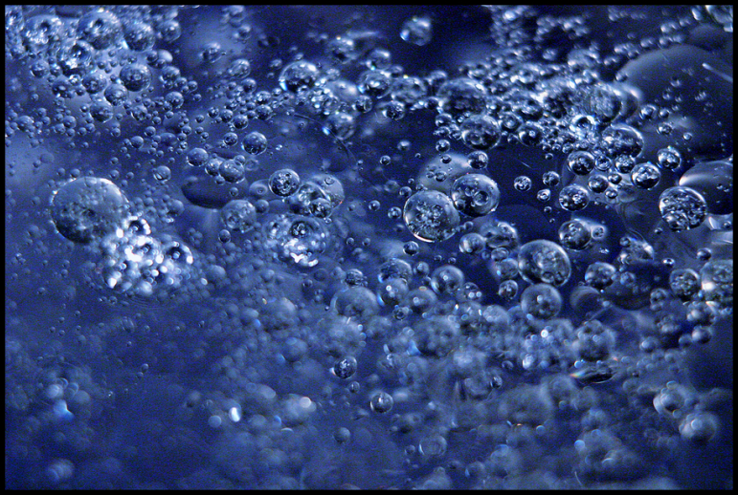

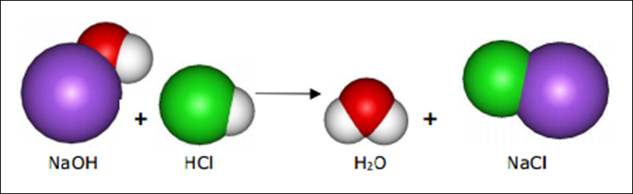
Double-Replacement/ Displacement Reactions
Neutralization Reaction
“Acid-base Reaction”
.
Compound
Compound
Compound

Slide 55
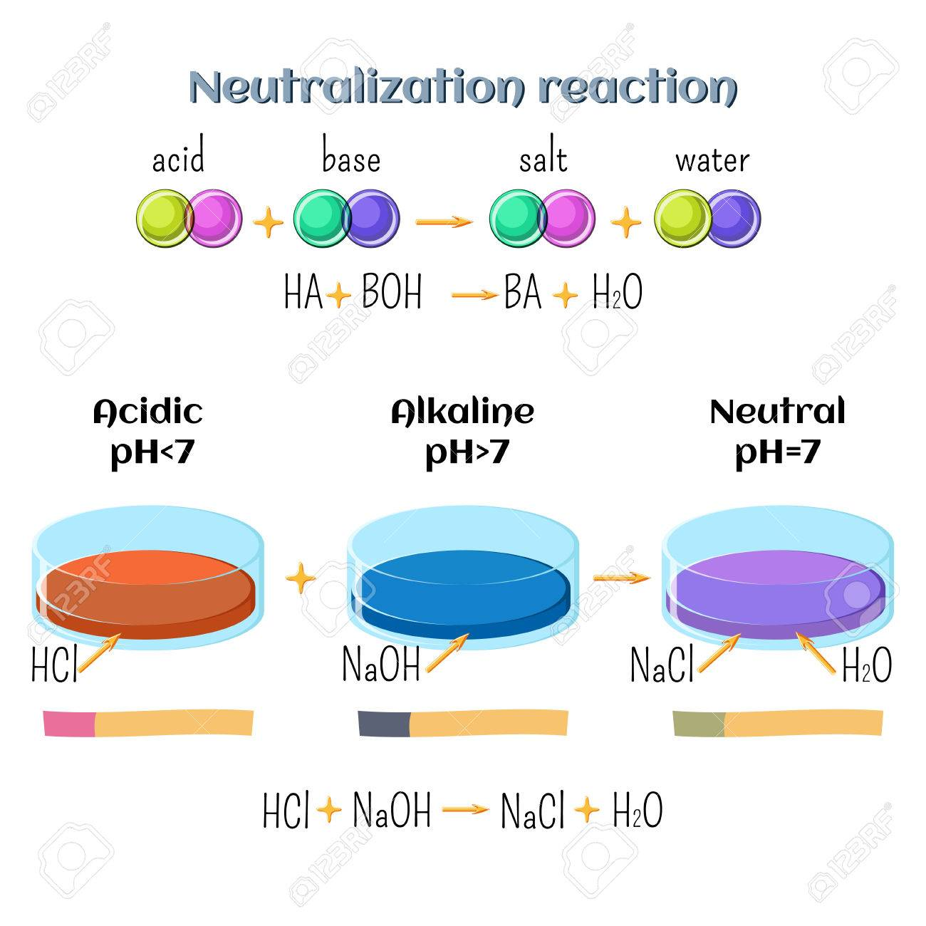
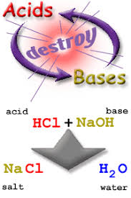
Acid-Base Reaction

Slide 56
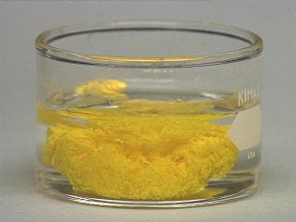
Double-Replacement Reactions
The formation of a precipitate occurs when the cations of one reactant combine with the anions of another reactant to form an insoluble compound.

Slide 57
5. Combustion Reaction
The reactant usually contains carbon and hydrogen (hydrocarbon) reacting with oxygen
Product is usually carbon dioxide (CO₂)and water (H₂O)
Where x= number of carbon atoms
Y= number of hydrogen atoms
C_{x}H_{y} + O₂ CO₂ + H₂O

Slide 58
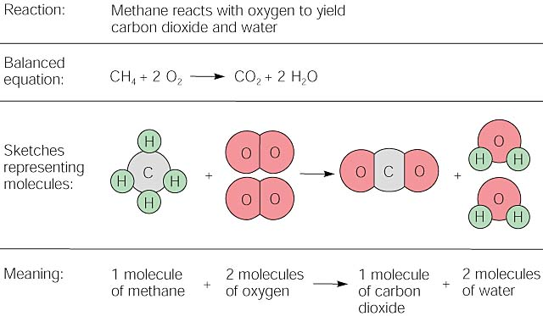
Combustion of methane gas

Slide 59
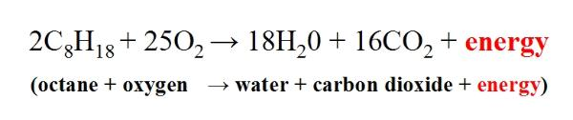
Example
Combustion of gasoline
Incomplete combustion (not enough Oxygen) can lead to the formation of Carbon and carbon monoxide )poisonous gas)

Slide 60
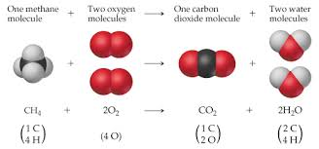

Slide 61
Checking for understanding 3
1. What is the difference between single replacement and double replacement reactions?
2. Give an example equation of a single replacement and a double replacement reaction;
3. What are the products of combustion reaction?

Slide 62
Checking for understanding 4
1. __KI + __Pb(NO₃)₂ → __KNO₃ +__PbI₂
2. __S + __O₂ → __SO₃
3. __KI + Cl₂ → __KCl + I₂
Double Replacement
Synthesis
Single Replacement

Slide 63
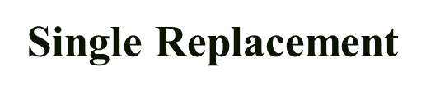
4. Mg + 2HCl → MgCl₂ + H₂
5. 2KClO₃ → 2KCl + 3O₂
_{6. Combustion reaction}
Decomposition

