Slide 1
Pricing

Slide 2
Warm Up
What is a price?
How does Supply and Demand impact pricing?

Slide 3
Homework: Final Review Presentations
Create a presentation on the topic that you have been assigned
Your Presentation needs to have some sort of visual/auditory component to it-(poster, song, chart, graph, diorama)
Prepare a script for your presentation and make sure your rehearse it
Presentations will be Tuesday- Dec. 13th

Slide 4
Learning Objectives
Engage in Visual Learning
Prepare for Final Exam: Dec. 21st (Wednesday)
Analyze Pricing Vocabulary

Slide 5
Go Over Final Review Presentation Handout
Read through handout on your Review Presentations for the Final
Each person will pick their topic (we will draw names)
You will have ten minutes to brainstorm ideas and think about how you want to present your topic

Slide 6

Indiana Jones: Supply, Demand, and Pricing
https://www.youtube.com/watch?v=RP0j3Lnlazs
In the scene where Indiana Jones was selling the diamond to the buyer, was the Law of Supply shown? Why or why not?
Do you think that Indiana Jones was doing the right thing by increasing the price? Why or why not?
In the Pet Snakes example, what is he saying about what happens to the price of a good when the supply increases? What is this saying about how Demand is impacted by pricing?

Slide 7
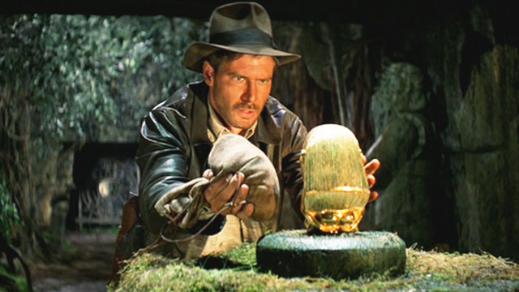
Indiana Jones: Supply, Demand and Pricing
What is the difference between the Supply Curve and the Demand Curve?
How is a Shortage and a Surplus created?
What is equilibrium in Supply and Demand?

Slide 8
Pricing Vocabulary
Price: The cost of a good/service
Quantity: How much of something someone has
Equilibrium: The point of balance between price and quantity
Surplus: The quantity supplied is greater than the quantity demanded
Shortage: Situation in which the quantity demanded is greater than the quantity supplied

Slide 9
Check for Understanding
What is the root word in “Equilibrium” that can help you remember the definition? How does this help you remember the definition?
What is the importance of finding Equilibrium for suppliers?
Is Equilibrium more important for suppliers or consumers?
How do you think having a Shortage would impact prices?
How do you think having a Surplus would impact prices?

Slide 10
Pricing Simulation: Who can make the most money by finding Equilibrium?
I need two volunteers to be chip producers
Each producer will have 10 bags of chips
Each producer will decide the price of their chips at the beginning of each round
Each consumer will have $10
Each consumer can only buy 1 bag of chips per round
We will be keeping track of how many chips were bought at each price for each producer

Slide 11
Analyzing the Pricing Simulation
Who made the most money and how did they make the most money?
What does this tell you about the importance of pricing in Economics?
Why is it essential for businesses to find Equilibrium?
What factors do you think could impact a businesses’ Equilibrium?

Slide 12
In-Class time to Start Review Presentations Homework
Use this in-class time to start your review presentation homework
Suggestion: Start writing out your summary of how you plan to present the topic
Make sure that you fully understand the topic: IF YOU DON’T, NOW IS THE TIME TO ASK

Slide 13
Exit Ticket
What is Equilibrium?
Why is Equilibrium important for suppliers and consumers?

Slide 14
Warm Up
What is Equilibrium?
What is the connection between Equilibrium and Supply/Demand?

Slide 15
Homework: Final Review Presentations
Create a presentation on the topic that you have been assigned
Your Presentation needs to have some sort of visual/auditory component to it-(poster, song, chart, graph, diorama)
Prepare a script for your presentation and make sure your rehearse it
Presentations will be Tuesday- Dec. 13th

Slide 16
Learning Objectives
Analyze government intervention in pricing
Interpret how Rent Control is impacting San Francisco
Build Connections to your life

Slide 17
Brainstorming
What does “government intervention” mean?
Is it a good or bad thing when the government intervenes in the economy?
What forms of government intervention have we already looked at?
What type of economy has the most government intervention?
What type of economy has the least government intervention?

Slide 18
Government Intervention in Pricing
Price Ceiling: A maximum price that can be legally charged for a good/service
Price Floor: A minimum price for a good/service
Rent Control: A Price Ceiling placed on rent

Slide 19
Check for Understanding
What is a Floor? How can you use this word to help you remember what a Price Floor is?
Can you think of any examples of Price Floors? (HINT: THINK OF JOBS THAT YOU MIGHT HAVE OUTSIDE OF SCHOOL)
What is a Ceiling? How can you use this word to help you remember what a Price Ceiling is?
Why is Rent Control an example of a Price Ceiling?
Is Rent Control a good or bad thing? Why do you think this?

Slide 20
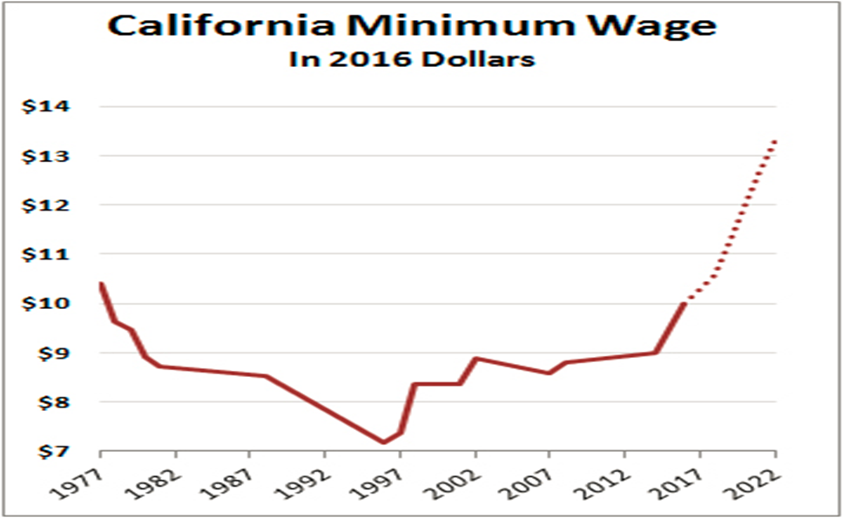
Best Example of a Price Floor: Minimum Wage
What factors do you think impact Minimum Wage?
What is the graph showing about Minimum Wages in the future? How do you think this is going to impact Cali’s economy?

Slide 21
Rent Control in San Francisco
With a partner, read the article on Rent Control in San Francisco and answer the questions that follow
We will then come together as a class and re-read the article
Please ask any questions that you have about words that you don’t understand the meaning of

Slide 22
You Create the Solution
In 2-3 sentences, describe the Rent Control problem in San Francisco
Create an outline (bullet-point list) of a plan to solve the problem of Rent Control in San Francisco
List must have at least 10 bullets
Create a visual/graphic under your list that illustrates the problem and the plan to fix the problem

Slide 23
Exit Ticket
What is good about Rent Control?
What is bad about Rent Control?
How is Rent Control an example of government intervention in the economy?
Do you think the government needs to interfere more or less with the economy?

Slide 24
Warm Up
What is a Price Floor? Give an example of a Price Floor and explain why this is an example of a Price Floor
What is a Price Ceiling? Give an example of a Price Ceiling and explain why this is an example of a Price Ceiling

Slide 25
Homework: Final Review Presentations
Create a presentation on the topic that you have been assigned
Your Presentation needs to have some sort of visual/auditory component to it-(poster, song, chart, graph, diorama)
Prepare a script for your presentation and make sure your rehearse it
Presentations will be Tuesday- Dec. 13th

Slide 26
Learning Objectives
Interpret the meaning of a Subsidy
Engage in Collaborative Learning
Analyze factors that impact Pricing

Slide 27
Retaining Material
Why did the word “subsidy” come up last class?
What did we say this meant?
Can you think of other examples of subsidies?

Slide 28
Forms of Government Intervention: Subsidies and Excise Taxes
Subsidies: Payments that governments make to help and support a business/industry
Excise Taxes: Tax on the production or sale of a good

Slide 29
Check for Understanding
What examples of Subsidies can you think of?
What examples of Excise Taxes can you think of?
Why would a government use Subsidize a business/industry?
Why would a government place an Excise Tax on a good/service?

Slide 30
Examples of Excise Taxes
Cigarette Taxes
Alcohol Taxes
High-Pollutant Gasoline
Highway Usage of Trucks
Private Luxury Airplanes

Slide 31
Examples of Subsidies
FDR’s New Deal Program
Food Stamps- How is this an example of a Subsidy?
Medical Insurance
Solar Energy
Indonesia- National Car Company
France: Small Farms- Why do you think the French would do this?
US Post Office- Why do you think the US would do this?

Slide 32
Group Work- Subsidy Skit
In a group of 3 people, you will be given an example of a Subsidy, and asked to write out a skit that demonstrates how this impacts different people
Include a narrator, a producer, a government economist, a government regulator, and a consumer of the product
You need to write out a script for your skit that is 3-4 minutes long and demonstrates how a government subsidy impacts groups of people differently
Be sure to consider the Pros and Cons of a Subsidy for each person in the group
Everyone in the group needs to have a role

Slide 33
Group Presentations
Remember Good Public Speaking Skills:
-Engaging Voice
-Rehearse what you will be saying
-Make eye contact with the audience
-Good pacing: Don’t go too fast or too slow
-Be aware of body movements
-Stay Chill

Slide 34
Check for Understanding
What is a Subsidy?
What other ways do we see government intervening in the economy?
Do you think the government intervening in the economy is good or bad? Why?
How does government interference in the economy impact pricing of goods/services?

Slide 35
Brainstorming
Think of 3 goods/services that have changed price within the last year
Think of 3 good/services that have rapidly changed price since WW2
What factors are impacting the changes in price of these goods/services? Why is the price of the good/services changing?

Slide 36
Factors that can impact Pricing
Search Costs: The financial and opportunity costs consumers pay in searching for a good/service
Surplus
Shortage
Changes to Equilibrium
a. Changing Technology
b. Changing Consumer Trends
c. More/less Competition
d. Rise/Decline in Supply of the good/service
e. Rise/Decline in Demand of the good/service

Slide 37
Check for Understanding
How would Search Costs impact the pricing of a good/service?
Which of these factors do you think will be most impactful on changing the price of a product? Rank them from most important to least important

Slide 38
In-class time to work on Review Presentations
Use this in-class time to start your review presentation homework
Suggestion: Start writing out your summary of how you plan to present the topic
Make sure that you fully understand the topic: IF YOU DON’T, NOW IS THE TIME TO ASK

Slide 39
Warm Up
Identify a current good/service whose price will greatly change (either increase or decrease) in the next 20 years, and explain why the price of this good/service will change

Slide 40
Homework-Final Review Presentations
Create a presentation on the topic that you have been assigned
Your Presentation needs to have some sort of visual/auditory component to it-(poster, song, chart, graph, diorama)
Prepare a script for your presentation and make sure your rehearse it
Presentations will be Tuesday- Dec. 13th

Slide 41
Learning Objectives
Analyze factors that impact pricing
Enhance Public Speaking Skills
Review for the Final

Slide 42
Go over Warm Up question: Fun With Whiteboards
We will write on the board the good/service that each individual picked
For each person’s good/service, you will write on the whiteboards three reasons why this good/service will be changing price in the next 20 years
Make sure you are thinking about the different factors that impact pricing

Slide 43
20 Minutes: Summary of Review Presentation
Write one paragraph that explains what you will be doing for your presentation and the topic that you will be presenting
Be prepared to tell me what you need help with
Be sure to identify how much more work you need to complete until you are done preparing your presentation
Be ready to present your paragraph to the class

Slide 44
In-Class Summary Presentations
Remember Good Public Speaking Skills:
-Engaging Voice
-Rehearse what you will be saying
-Make eye contact with the audience
-Good pacing: Don’t go too fast or too slow
-Be aware of body movements
-Stay Chill

Slide 45
Review Sheet on Pricing
Fill out the Review Sheet on Pricing

Slide 46
Re-write the lyrics to a song to help study for the test
Pick a song and re-write the lyrics with concepts/terms that will be on the test
You need to re-write at least seven lines of the song
Be prepared to explain the meaning of the concepts/terms that are in your song!

Slide 47
Warm Up
What do you think is the hardest concept/term to understand, that will be on the test
Why do you think this is so hard to understand?

Slide 48
Homework: Final Review Presentations
Create a presentation on the topic that you have been assigned
Your Presentation needs to have some sort of visual/auditory component to it-(poster, song, chart, graph, diorama)
Prepare a script for your presentation and make sure your rehearse it
Presentations will be Tuesday- Dec. 13th

Slide 49
Looking Ahead
Next Class= Presentation Day!!!
Make sure that you bring in your presentation and rehearse what you will be presenting
Reminder: Your job is to teach your classmates about your review topic…if you don’t prepare a presentation, you will not only be hurting your grade, but the grade of the rest of your classmates

Slide 50
Learning Objectives
Engage in Collaborative Learning
Review for Final
Synthesize the connection between Supply/Demand and Pricing

Slide 51
Pair-Share Warm Ups
Switch Warm-Ups with a partner
Have your partner explain the term/concept that you think will be most difficult to remember for the Final
Between the two of you, decide which term/concept you would like to go over as a class

Slide 52
Study Guides
For each term/concept on the study guide, fully write out all notes and examples that we went over in class

Slide 53
Recalling Information
What factors impact the price of a product?
Identify three goods/services that you think will greatly change price in the next 20 years
What is the connection between Demand/Supply and Pricing?

Slide 54
Pricing Skit
In Groups of 3-4 people, create a skit that demonstrates how Supply and Demand impacts price changes of a good/service
Focus on one of the goods/services that you wrote about in which the price has changed
In your skit, be sure to show and explain how different factors led to change in price
Everyone in the group most have a role in the skit: Producer, Consumer, Supplier, Economist, Narrator, Competitive Rival, Government Rep., etc.

Slide 55
Charades: Review for the Test
You will get a card with a term/concept that we have been over
You will be asked to act out the word
You can’t make noises
You can’t draw
If you guess someone else’s word, you either get to go up next, or someone can pick you to go up and act out the next word
If you can act out 5 words and the class gets them right, you get extra credit on the Final

Slide 56
Warm Up
Get ready to present-REHEARSE

Slide 57
Homework
Study for the Final: Dec. 21st

Slide 58
Learning Objectives
Enhance Public Speaking Skills
Review for Final
Engage in Collaborative Learning

Slide 59
Pair-Share Warm Ups
Switch Warm-Ups with a partner
Have your partner answer any questions that you might have
If you or your partner still have questions, ASK THEM!!!

Slide 60
Final touches on Presentations: 5 Minutes
Take 5 minutes to make sure that you are ready to present your topic
Make sure you rehearse what you will be saying
Think about what questions the class might have for you

Slide 61
Final Review Presentations
Remember good public speaking skills:
-Engaging Voice
-Rehearse what you will be saying
-Make eye contact with the audience
-Good pacing: Don’t go too fast or too slow
-Be aware of body movements
-Stay Chill

Slide 62
Presentation Rubrics: How you will be graded
-Purpose: Presentation topic is clearly stated and explained
-Organization: Content of presentation is clearly organized
-Support/Ideas: Themes and main ideas are supported and explained
-Evidence: Examples are provided to support presentation topic and explanation of topic
-Summary: Presenter should summarize presentation

Slide 63
Kahoot.IT
THIS IS ONE TIME THAT YOU WILL BE ALLOWED TO USE YOUR CELL PHONES
Login to Kahoot. It
Enter your name
Plug in the Pin Code that I will show you
Winner= 10 points extra credit on quiz
2nd Place= 7 points extra credit
3rd place= 5 points extra credit

Slide 64
The Social Network
Fill out the question and answer sheet for The Social Network

Slide 65
Warm Up
What term/concept/person/place/idea/theory that we learned about this semester in Economics do you think is going to be most impactful in your life
Write 2-3 sentences to explain why this is going to be most impactful

Slide 66
Homework
Study for the Final-Dec. 21st

Slide 67
Learning Objectives
Enhance studying skills
Synthesize Economics
Engage in Visual Learning

Slide 68
Share Warm-Ups
Everyone will share their Warm Ups with the class
Make sure you explain why the term/concept/person/place/idea/theory is going to be most impactful for you

Slide 69
Jeopardy
You will be divided into groups
Your group will pick a question from one of the different categories and then pick how many points you want to go for in that category
You have 45 Seconds to answer the question
If your group gets the question wrong, it goes to the next group
The next group has 30 seconds to answer the question

Slide 70
Password
One person will come up to the front of the class
The person will be given a card that has a term/concept that we have been over in class
The person is allowed to give only one clue to each of their classmates
Only one classmate is allowed to go at one time

Slide 71
The Social Network
Fill out the question and answer sheet for The Social Network

