Slide 1
The Atom

Slide 2
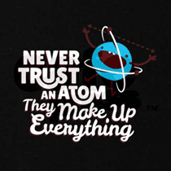

Slide 3
The Atom
The basic unit of matter
An atom is the smallest particle of an element that retains (keeps) the properties of that element
Atoms are made up of even smaller particles called subatomic particles

Slide 4
The Structure of the Atom
* Each atom has a nucleus made up of protons and neutrons. * Each atom has an electron cloud (1 or more electrons rapidly orbiting the nucleus).
Proton = +1 charge, mass of 1 amu
Neutron = 0 charge (neutral), mass of 1 amu
Electron = -1 charge, mass of 1/2000th amu

Slide 5
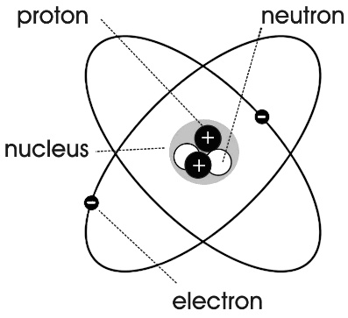
The nucleus (protons and neutrons) has “all the mass”
The electrons have “all the space”
* An atom is neutral because the number of protons equals the number of electrons.

Slide 7
* The atomic symbol is the scientific shorthand (abbreviation) used to identify (name) the element. * The atomic number of an element is equal to the number of protons in its nucleus. * The atomic mass number of an element is the sum of the number of protons and the number of neutrons in the nucleus of the element. # protons + # neutrons = atomic mass

Slide 8
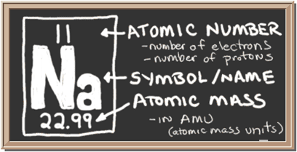
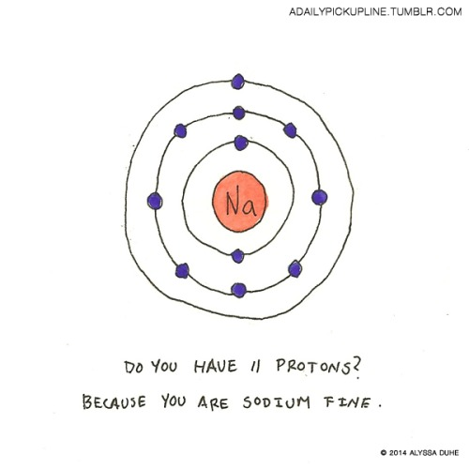
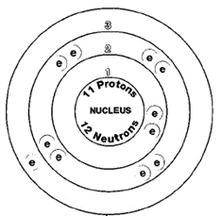

Slide 9
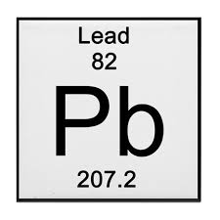
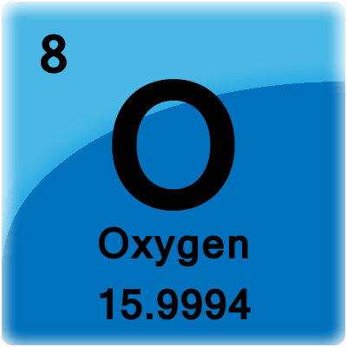
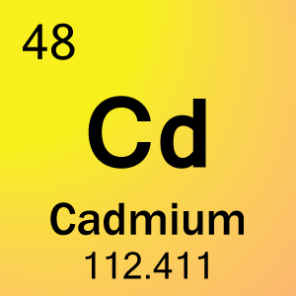
* Let’s Practice

Slide 10
Oxygen
Atomic Number = 8
Atomic Mass = 16* (WHAT)
# Protons = 8
# Neutrons = 8
# Electrons = 8

Slide 11
Cadmium
Atomic Number = 48
Atomic Mass = 112.411
# Protons = 48
# Neutrons = 64
# Electrons = 48

Slide 12
Lead
Atomic Number = 82
Atomic Mass = 207.2
# Protons = 82
# Neutrons = 125
# Electrons = 82

