Slide 1
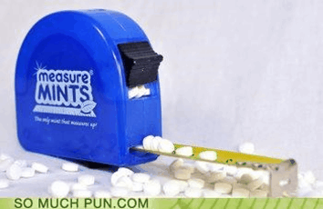
Measurement & the Metric System

Slide 2
Measurement
• The dimensions, capacity, or amount of something
– Time
– Temperature
– Length
– Volume
– Mass

Slide 3
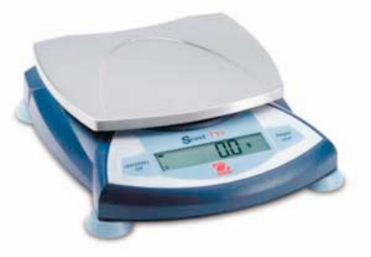
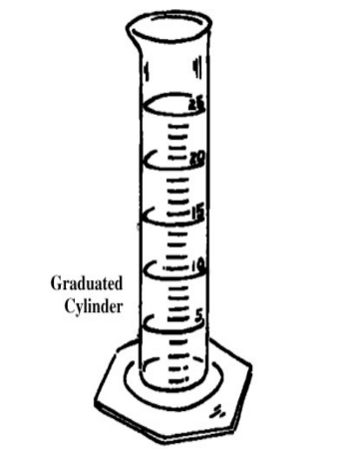
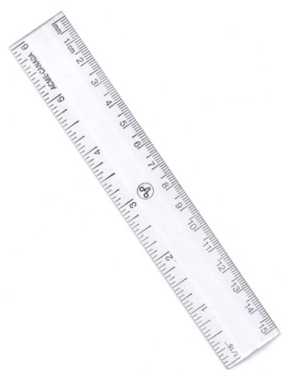
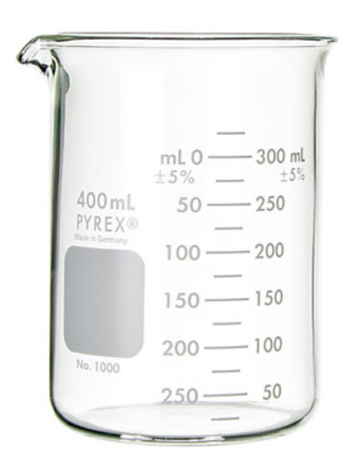
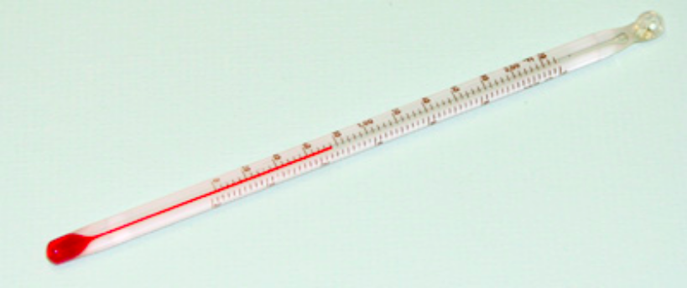
Measurement Definitions
Mass - the amount of matter Volume - the 3D space matter occupies Temperature - the average kinetic energy of the particles in matter Length - the longest linear dimension of matter

Slide 4
Standards of Measurement
When we measure, we use a measuring tool to compare some dimension (amount) of an object to a standard, an exact quantity that is agreed upon for comparison.

Slide 5
The Metric System
• Based on multiples of ten
• Uses “base units”
– Time: second (s)
– Temperature: Kelvin (K)
– Length: meter (m)
– Volume: liter (L)
– Mass: gram (g)

Slide 6
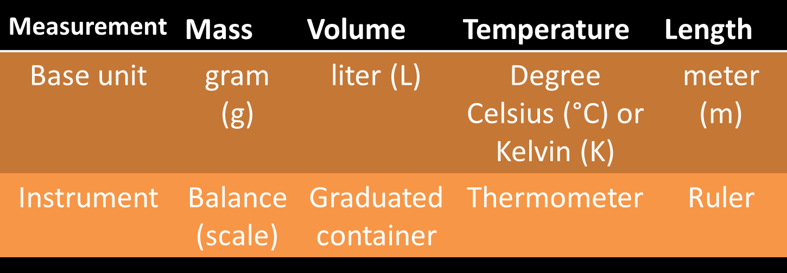
All of these are directly measured

Slide 7
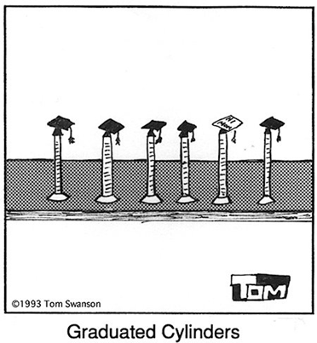
Graduated Cylinders

Slide 8
Learning Check
Identify the measurement in metric units.
1. John’s height is
A) 1.5 yards B) 6 feet C) 2 meters
2. The volume of saline in the IV bottle is
A) 1 liters B) 1 quart C) 2 pints
3. The mass of a lemon is
A) 12 ounces B) 145 grams C) 0.6 lbs

Slide 9
Learning Check
Identify the measurement in metric units.
1. John’s height is
A) 1.5 yards B) 6 feet C) 2 meters
2. The volume of saline in the IV bottle is
A) 1 liters B) 1 quart C) 2 pints
3. The mass of a lemon is
A) 12 ounces B) 145 grams C) 0.6 lbs

Slide 10
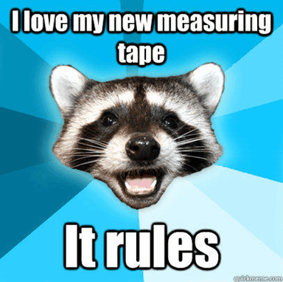

Slide 11
Why are units important?
You are driving to visit a friend and get lost - Google Maps is not working!!! You stop and ask a stranger walking his dog for directions, and he seems to know where you want to go.
“Take a left at the next stoplight, and then go five _________. ”
“After that, make a right and go through three ________.”
“You should see a Starbucks straight ahead, go two _______ past that.”
“Your friend’s _______ should be fifth on the right.”

Slide 12
Complete the units sort with your partner.
Separate the cards into five groups – examples of
Time
Length
Temperature
Mass
Volume

