Slide 1
Matter

Slide 2
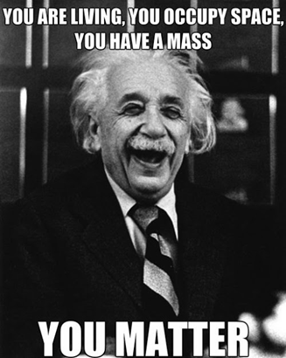
Matter
Matter is any thing that takes up space and has mass.
Toothpaste | The ocean | Batteries | Gasoline | Heat
Electricity | Fear | Saliva | Paper | A dog
A star | DNA | Helium | Bacteria | Wind
Juice | Peanut Butter | Democracy | A cell | Atoms
Sound | Clouds | Car exhaust | Wisdom | Soil

Slide 3
Matter can be made up of only one substance (pure), or any number of different substances (mixture). A substance is a type of matter with a fixed composition: element or compound.

Slide 4
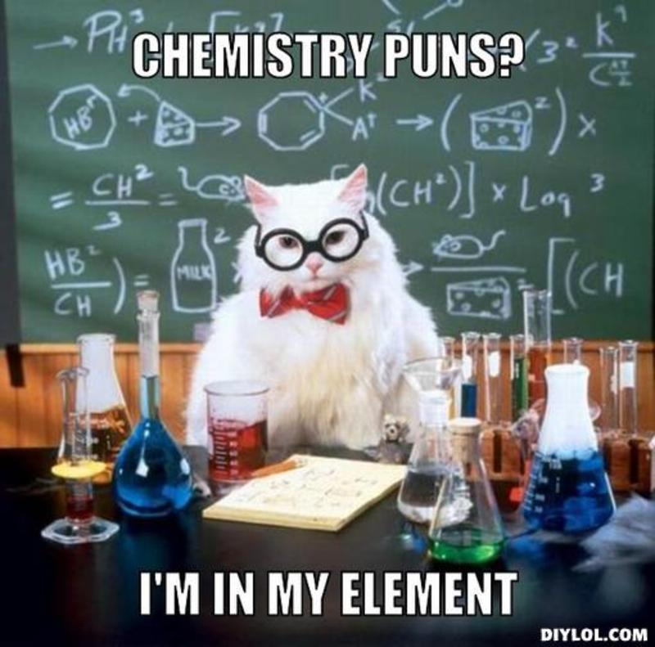
Element
§ An element is the simplest form of matter. § An element is a substance that only has one type of atom. § An element is homogeneous.

Slide 5
Molecule
§ A molecule is a combination of two or more atoms.
Compound
§ A compound is a combination of two or more elements. § A compound is homogeneous.

Slide 6
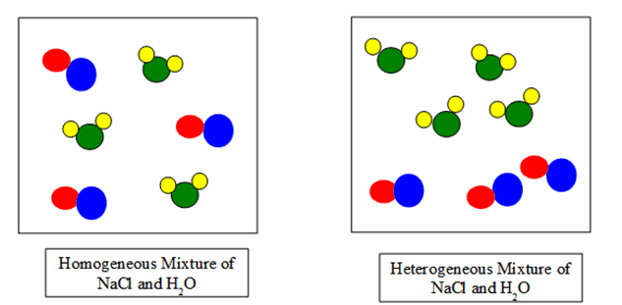
Mixture
Contains two or more chemical substances that retain their individual identities.
Mixtures can be separated
Two types: homogeneous & heterogeneous
Homogeneous – remains contantly and uniformly mixed (also known as a solution)
Heterogeneous – different compounds remain distinct

Slide 7
Identify whether the following are elements (E), compounds (C) or mixtures (M)

Slide 8
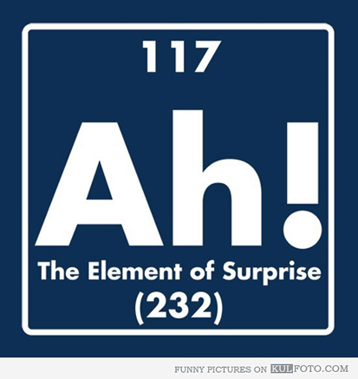

Slide 9
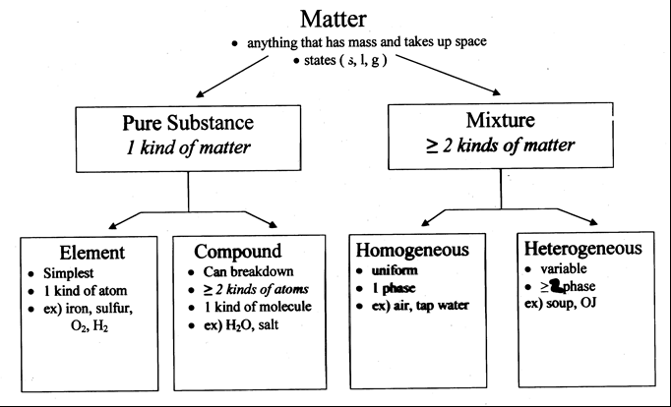
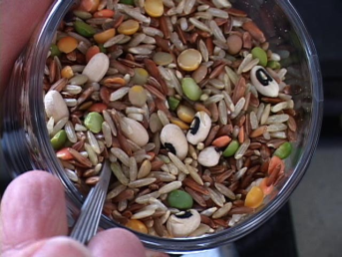
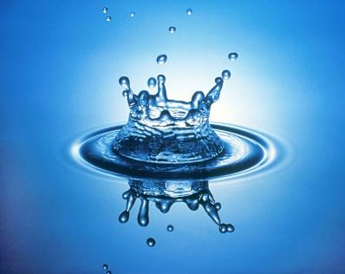
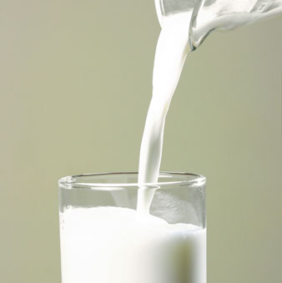
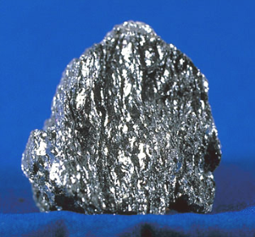
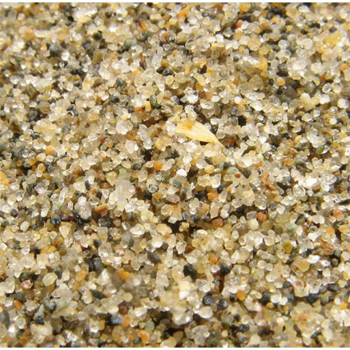
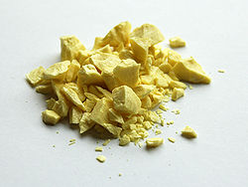

Slide 10
Brain break!
Based on the previous notes classify the following as a compound, an element, a homogeneous mixture or a heterogeneous mixture:
Blood
Chocolate chip cookie
Glucose (C₆H₁₂O₆)
Filtered hot tea
The gas in a scuba divers tank
Carbon (C)
Distilled water

Slide 11
Brain break!
Based on the previous notes classify the following as a compound, an element, a homogeneous mixture or a heterogeneous mixture:
Blood – homogeneous mixture
Chocolate chip cookie – heterogeneous mixture
Glucose (C₆H₁₂O₆) – compound
Filtered hot tea – homogeneous mixture
The gas in a scuba divers tank – homogeneous mixture
Carbon (C) – element
Distilled water – compound

Slide 12
Physical Property
A physical property is any characteristic of a material you can observe without changing the identity of the substance (what the substance is and does)
Intensive – does not depend on the amount of the substance (density, malleability, color, melting point, boiling point)
Extensive – does depend on the amount (mass, length, volume)

Slide 13
Classification of Properties....
Extensive properties - depend on the amount of matter that is present Intensive properties - do not depend on the amount of matter present
identify extensive and intensive properties
Volume | Melting Point | Mass | Boiling Point
Freezing point | Energy | Density | Magnetic
Conductive | Length | Color | area

Slide 14
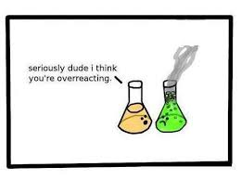
Chemical Property
A chemical property is any characteristic of a material that you can observe that produces one or more new substances. (how a substance reacts with other substances)
Decomposition, explosion, reactivity, burning

Slide 15
