Slide 1
Systems, Energy & Kinetic Molecular Theory
Learning Targets 1.6 and 2.1

Slide 2
One of the main goals of Chemistry is to study energy flowing from one place to another during chemical or physical changes in order…
…to determine the quantity of heat exchanged between a system and its surroundings.
System: Part of the universe being studied (usually a chemical reaction)
Surroundings: The rest of the universe that interacts with the system

Slide 3
What are systems and how do they respond to change?
Open system: exchanges of matter and energy occur across boundaries
Closed system: No matter and energy exchanges across boundaries (occur way less)
Inputs: additions to a system
Outputs: losses from a system

Slide 4
System Analysis
Determine the inputs and outputs of a system and evaluate change
Steady state: when inputs = outputs so the system isn’t changing

Slide 5
Think about it…

Slide 6
Heat, Energy & Temperature
https://www.youtube.com/watch?v=QzLWXXt9MRA&

Slide 7
Energy = the ability to do work or transfer heat
Kinetic Energy = moving energy
Ex: wind, heat, electromagnetic radiation
Potential Energy = stored energy
Unlit match, nuclear energy stored in nuclei of atoms, chemical energy (energy in food)

Slide 8
Kinetic Molecular Theory (KMT)
The word kinetic means “motion.” The energy an object has because of its motion is known as Kinetic Energy.
According to KMT, ALL matter consists of tiny particles that are in constant, random motion.
The higher the temperature, the greater the motion of particles.

Slide 9
Kinetic Energy and Temperature
As a substance is heated, its particles absorb energy, and the particles move faster.
The faster the particles, the greater the kinetic energy, the higher the temperature. Why?
The temperature of a material is a measure of the average kinetic energy of the particles that make up the material.
At any given temperature, the particles of all substances, regardless of physical state, have the same average kinetic energy.

Slide 10
Characteristics of the States of Matter

Slide 11
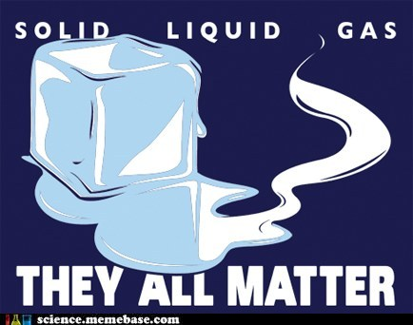

Slide 12
Gases
The large space between particles explains why gases can be compressed easily.
No attractive forces exist b/w particles.
Gas particles undergo rapid, constant, and random motion so an uncontained gas can spread out into space without limit. (diffusion)
Particles collide and reverse directions often.
Collisions b/w particles in a gas are perfectly elastic (no energy is lost in the collision, so they never slow down). Collisions cause gas pressure.

Slide 13
Liquids
Unlike gases, there are attractive forces between particles in a liquid.
These interparticle forces keep the particles in a liquid close together.
Particles in a liquid slide past one another.
Liquids are not easily compressed (little space between particles).
Therefore, liquids are more dense than gases.

Slide 14
Solids
The particles of a solid are packed tightly together and are not easily compressed.
Particles in a solid vibrate in place.
Most solids are crystalline. Particles are arranged in an orderly, repeating, three-dimensional pattern called a crystal lattice.
Non-crystalline solids (amorphous solids) lack an ordered internal structure. Ex. glass & plastic.

Slide 15
For Review

Slide 16
Effort Needed to Compress

Slide 17
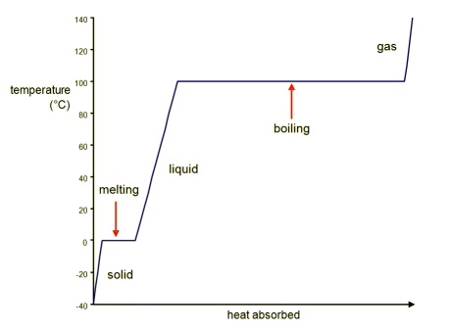
Heating & Cooling Curves

Slide 18
Heating & Cooling Curves

