Slide 1
Nuclear Chemistry – Radioactive Decay

Slide 2
The discovery of radiation
In 1896 Henri Becquerel made an important discovery.
He accidentally had placed a piece of uranium ore on top of an unexposed photographic plate. Later, when the plate was developed, the image of the rock was found on the plate.
Based on further experiments, he concluded that the plate had been exposed by rays given off by the uranium.

Slide 3
Madame Curie discovers Radium and Polonium
Following Becquerel’s discovery, Marie Sklodowska Curie and her husband, Pierre Curie, attempted to isolate the “radioactive” material from the uranium ore.
In doing so they discovered two new elements, Radium and Polonium, both of which were more radioactive than the original ore.

Slide 5
Revise your definition of Radioactivity from Arc 2
Look at your band of stability – some of the elements are radioactive on your graph and some of the elements are not. What makes an element radioactive?

Slide 6
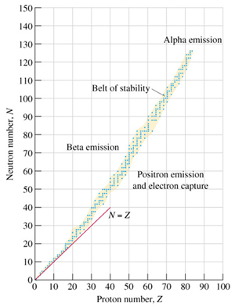
Band of Stability Review
Nuclear stability depends on the proton to neutron ratio in a nucleus.

Slide 7
Nuclear Stability
Nuclei with even numbers of both protons and neutrons are generally more stable than those with odd numbers of these particles.
Nuclei that contain certain specific numbers of protons and neutrons within a nucleus ensure an extra degree of stability. These so-called magic numbers for protons and for neutrons are 2, 8, 20, 28, 50, 82, and 126.
All isotopes of elements after bismuth (Z = 83) are radioactive.

Slide 8
Fun Fact: Using the band of stability, you can determine what type of decay an unstable isotope will undergo. Complete the Chemistry I-SPY

Slide 9
Ernest Rutherford
Rutherford investigated this new property of matter and discovered that, in the process of emitting radiation, atoms of one element became atoms of another element.
Today, we describe the process of an atom of one element becoming an atom of a different element as transmutation.

Slide 10
Rutherford discovered the different types of radiation
Rutherford was the first to identify and name two different types of radiation given off when an atom of one element underwent transmutation and became an atom of another element. The two types of radiation he found were:
The alpha particle (α)
The beta particle (β)
A third type of radiation that was discovered later is called:
Gamma radiation (γ)

Slide 11
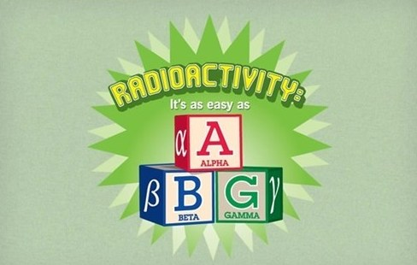

Slide 12
The properties of the different types of radiation
The differences between the three types of radiation can be seen by passing them through an electric field.

Slide 13
Characteristics of an alpha particle
The alpha particle (α) is deflected to some extent toward the negative plate.
This indicated that it is positively (+) charged and has a fairly large mass.
Today we know that an α particle is the same as the nucleus of a He atom.

Slide 14
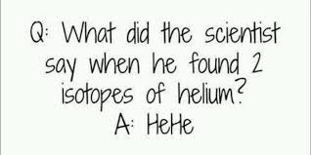

Slide 15
Characteristics of a beta particle
The beta particle (β) is deflected toward the positive plate (+). It is also deflected more than the α particle
This indicates that it is negatively (-) charged and has a much smaller mass than the α particle.
Today we know that a β particle is the same as an electron.

Slide 16
Characteristics of gamma radiation
Gamma radiation (γ) is not deflected toward either the positive (+) or negative (-) plate.
This indicates that it has no charge.
Today we know that gamma rays are a type of electromagnetic radiation made up of photons (packets of energy).

Slide 17
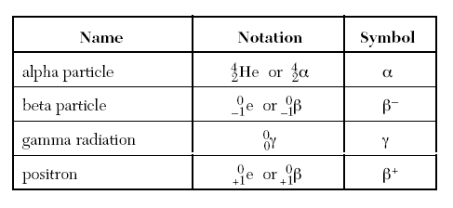

Slide 18
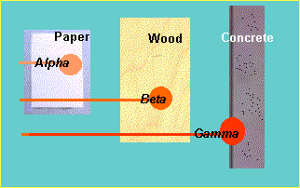
www.epa.gov

Slide 19
Penetrating power of radiation
The ability of radioactive particles to pass through air and other materials is inversely related to their mass.
Alpha particles – the least penetrating, they travel only a few centimeters through air. They can be stopped by a single sheet of paper.
Beta particles – more penetrating, they travel several meters through air. They can be stopped by a sheet of Al or plastic.
Gamma Rays – most penetrating, thick sheets of lead or concrete are required to stop gamma rays.

Slide 20
Where does the radiation come from?
Rutherford suggested that the radiation resulted from the breakdown of the nucleus of an atom, resulting in radiation being given off, and the nucleus of the atom changing into a new element.
For instance, the fact that U-238 undergoes alpha decay (emits an α particle) can be shown by this reaction:

Slide 21
Revise your definition of radioactivity again.

Slide 22
What do we mean by Radioactivity?
Radioactive decay is the process in which an unstable atomic nucleus loses energy by emitting radiation in the form of particles or electromagnetic waves.
There are numerous types of radioactive decay. The general idea:
An unstable nucleus releases energy to become more stable

Slide 23
Where does the radiation come from?
Rutherford suggested that the radiation resulted from the breakdown of the nucleus of an atom, resulting in radiation being given off, and the nucleus of the atom changing into a new element.
For instance, the fact that U-238 undergoes alpha decay (emits an α particle) can be shown by this reaction:

Slide 24
Balanced nuclear equations
Nuclear reactions can be represented by equations. These reactions are governed by two “laws”:
The law of conservation of mass number – the sum of the mass numbers on the reactant sides must be equal to the sum of the mass numbers on the product side.

Slide 25
The law of conservation of charge (atomic #) – the sum of the atomic numbers on the reactant sides must be equal to the sum of the atomic numbers on the product side.

Slide 26
Using Bohr models, demonstrate the law of conservation of Mass and the Law of Conservation of charge for the following nuclear equation.

Slide 27
Predicting products in alpha decay
The Law of Conservation of Mass Number and the Law of Conservation of Charge allows us to predict products in a nuclear reaction.

Slide 28
Predicting products
The mass number of particle X must be 218.
The charge (atomic #) of particle X must be 84.
The symbol of the element can then be determined from the Periodic Table.

Slide 29
How about beta decay?
It works the same way. Let’s look at the beta decay of Strontium-90.
Remember the sum of the mass numbers and atomic number on both sides MUST be the same.
So atom X must be:

Slide 30
Using balanced nuclear equations to identify the type of radioactivity.
Suppose we know that a particular atom undergoes radioactive decay and we are able to identify the atom that is produced.
For instance, Iodine-131 is known to form Xenon-131 when it decays. What radioactive particle must it emit?
Particle X must be a β particle:

Slide 31
Revise your definition of radioactivity again.

