Slide 1
Making Measurements

Slide 2
Measurement Station
Why are units important?
Why do units need to be standardized?

Slide 3
Looking for Patterns
Review your measurement example handout with your group. In your notebook, write down 5 similarities you notice between all of the measurements.
Do the same for your second example handout.

Slide 4
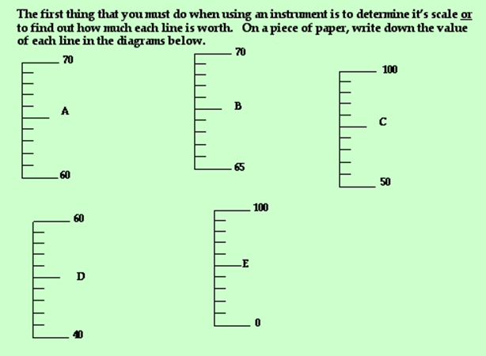
Making Measurements

Slide 5
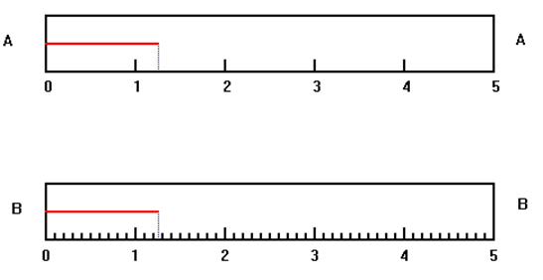
Significant Figures & Doubt
• Always go one digit past where the measuring tool is incremented for. This is known as reasonable doubt.
For example:

Slide 6
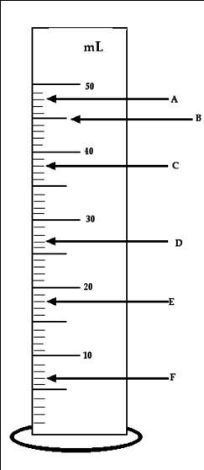
A. 48.1 mL
B. 44.9 mL
C. 38.0 mL
D. 27.2 mL
E. 17.9 mL
F. 7.1 mL

Slide 7
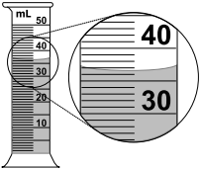
Practice
36.6 mL
41.45 °C

Slide 8
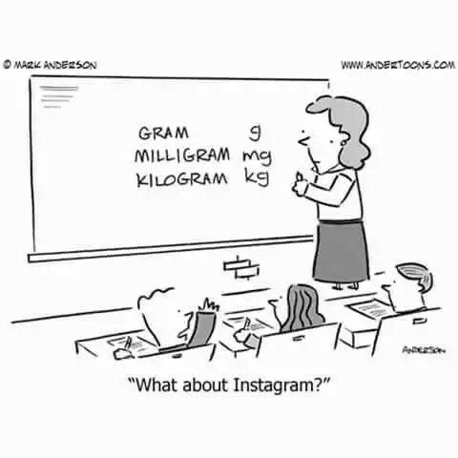
Pun

