Slide 1
Lewis Dot Structures & Polarity Review

Slide 2

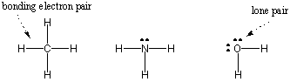
Dot Diagrams vs. Structures
Lewis Dot Diagrams show the number of valence of electrons electrons (in the form of dots) for a single element
Lewis Structures are diagrams that show the bonding between atoms of a molecule and the lone pairs that may exist in the molecule

Slide 3
Drawing Lewis Structures Review
Count up the valence electrons
Anions: add e– (CO₃²⁻ : add 2 e– ) Cation: subtract e– (NH₄⁺: minus 1 e– )
2. Determine the central atom
  Usually the first element is in the center (often C, never H)
Bond Terminal Atoms (update electron count)
Place remaining electrons around atoms in lone pairs (starting outside first)
  Place electrons in pairs (lone pairs)
  Too few? Form multiple bonds between atoms: double bond (4 e-) and triple bond (6 e-)
Check your structure!
Exceptions: Remember that H only needs 2e– !

Slide 4
Lewis Structure “Useful Hints”
C group: Forms a combo of 4 bonds and no LP (Lone Pairs)
N group: Forms a combo of 3 bonds and 1 LP
O group: Forms a combo of 2 bonds and 2 LP
F group (halogens): Forms 1 bond and 3 LP
  Note that these are NOT always true!

Slide 5
Lewis Structures Practice
Practice drawing the following compounds in your notebook.
CO₂ NH₃ HCl CH₄

Slide 6
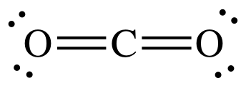

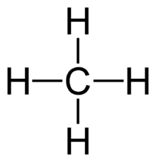
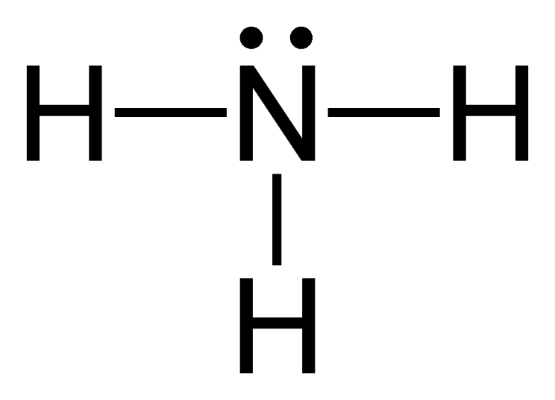
Lewis Structures Practice - ANSWERS
CO₂ NH₃ HCl CH₄

Slide 7
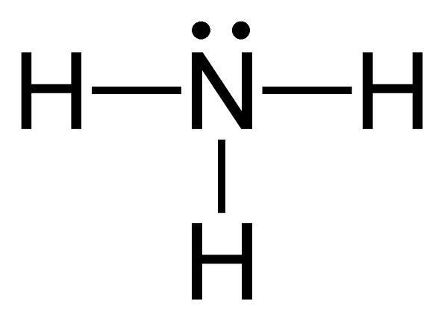
How do you determine if a structure is polar or nonpolar?
A structure will be nonpolar if is symmetrical around the central atom.
A structure will be polar if it is asymmetrical around the central atom.

Slide 8
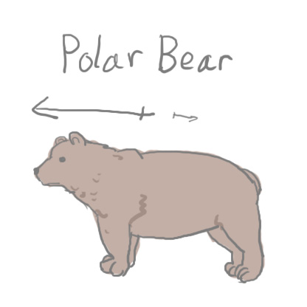


Slide 9
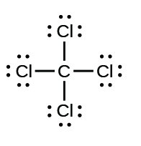
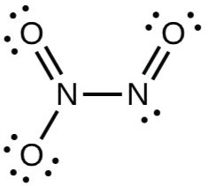
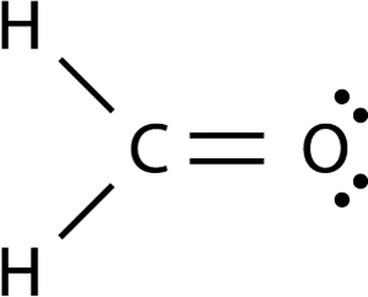
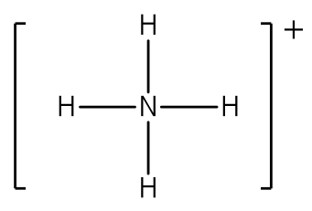
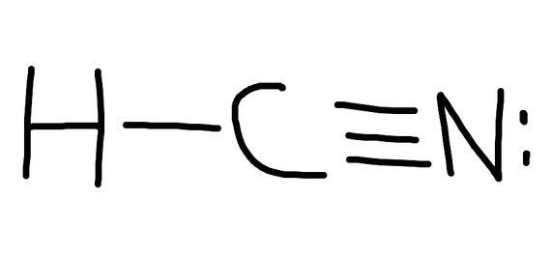
Identify the following structures as polar or nonpolar.

Slide 10
Identify the following structures as polar or nonpolar.
NONPOLAR
POLAR
POLAR
NONPOLAR
POLAR

