Slide 1
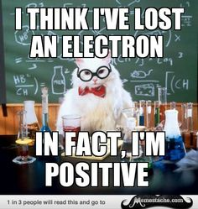
Writing Ions

Slide 2
Ion – an atom that has gained or lost electrons, formed when electrons are exchanged in the formation of an ionic compound.
There are 2 Types of Ions
Monoatomic ion – a single atom that has gained or lost electrons Polyatomic ion – a group of bonded atoms that have gained or lost electrons
Na⁺ Cl⁻ O⁻²
NH₄⁺ OH⁻ CO₃⁻²
In either case the # protons do not = # electrons

Slide 3
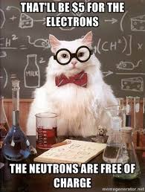

Slide 4
OK Lets not get confused ....Clarification of symbol numbers!
Chemical Symbol Nuclear symbol Ion symbol Chemical Formula

Slide 5
Two (2) Types of Monoatomic Ions
Cation – formed when a neutral atom loses one or more electrons Ex) Lithium atom (Li) becomes the Lithium ion (Li⁺) when it loses 1 electron Ex) Calcium atom (Ca) becomes the Calcium ion (Ca⁺²) when it loses 2 electrons What would Aluminum do?

Slide 6
Two (2) Types of Monoatomic Ions
Anion – formed when a neutral atom gains one or more electrons Ex) Chlorine atom (Cl) becomes the Chloride ion (Cl⁻) when it gains 1 electron Ex) Oxygen atom (O) becomes the Oxide ion (O⁻²) when it gains 2 electrons What would Nitrogen do?
Whoa....gain e⁻ are negative and loss of e⁻ are positive?!?!?!

Slide 7
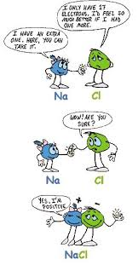
Happiness is a full outer shell.

Slide 8
Polyatomic ions – act as a group in compounds Ex) Ammonium ion (NH₄⁺) Ex) Sulfate ion (SO₄⁻²) Transition metal ions (a special case of Cations) – they can form more than one type of ion. (YIKES) Ex) Iron (II) ion Fe⁺² Ex) Iron (III) ion Fe⁺³

Slide 9
What would be the Ion?
Beryllium:
Sulfur:
Copper (II) Ion:

Slide 10
What would be the Ion?
Beryllium: Be⁺²
Sulfur: S⁻²
Copper (II) Ion: Cu²⁺

Slide 11
There are 9 Polyatomic Ions You NEED to MEMORIZE – Make FLASHCARDS!
The are circled on your green sheet – you must know the formula and the name for each.
Ammonium
Acetate
Cyanide
Bicarbonate
Hydroxide
Nitrate
Carbonate
Sulfate
Phosphate

Slide 12
a) nitrate ion Bromide ion Hydroxide ion d) Copper (II) ion

Slide 13
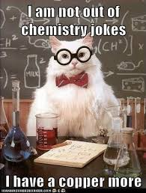
a) nitrate ion → NO₃⁻ nitride ion → N⁻³ Hydroxide ion → OH⁻ d) Copper (II) ion → Cu⁺²

