Slide 1
Warm Up Naming Ions:
Aluminum Ion |  | Selenide ion
Ammonium ion |  | Bromide ion
Barium ion |  | Carbonate ion
Caesium ion |  | Chloride ion
Chromium (III) ion |  | Oxide ion
Cobalt (II) ion |  | Nitride ion
Copper (I) ion |  | Fluoride ion
Lithium ion |  | Hydroxide ion
Iron (III) ion |  | Iodide ion
Phosphate ion |  | Nitrate ion

Slide 2
Warm Up Naming Ions:
Aluminum Ion | Al⁺³ | Selenide ion | Se⁻²
Ammonium ion | NH₄⁺ | Bromide ion | Br⁻
Barium ion | Ba⁺² | Carbonate ion | CO₃⁻²
Caesium ion | Cs⁺ | Chloride ion | Cl⁻
Chromium (III) ion | Cr⁺³ | Oxide ion | O⁻²
Cobalt (II) ion | Co⁺² | Nitride ion | N⁻³
Copper (I) ion | Cu⁺ | Fluoride ion | F⁻
Lithium ion | Li⁺ | Hydroxide ion | OH⁻
Iron (III) ion | Fe⁺³ | Iodide ion | I⁻
Phosphate ion | PO₄⁻³ | Nitrate ion | NO₃⁻

Slide 3
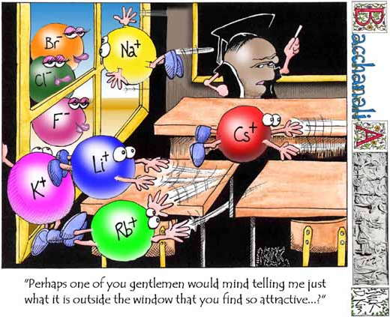
Writing and Naming Ionic Compounds

Slide 4
Important Vocabulary
Polyatomic Ions
Chemical Name
Chemical or Molecular Formula
Superscript
Subscript
A covalently bonded group of atoms with a charge that act as one unit
The name of a compound or molecule that identifies the elements in it
A notation that shows what elements a compound, or molecule, contains & in what ratio those elements exist
A number written above an element symbol (Ex. Cl¹⁻)
The number written below an element symbol (Ex. H₂O)

Slide 5
Atoms form compounds to lower the energy of the atom. In ionic compounds they do this by: 1. filling the outer orbitals 2. emptying the outer orbitals
Ionic Compounds
When two or more atoms fill or empty their valence shells by the donation or acceptance of electrons, the atoms are held together by ionic charges (+/-) and they form an ionic compound. The attractive force that holds them together is an ionic bond.
ALL IONIC COMPOUNDS ARE NEUTRAL This means the sum of the charges of all ions involved must be zero (0)

Slide 6
Making Ionic Compounds = Writing ionic Formulas
Step #1- Cation is written first Step #2 - All compounds are neutral (sum of the charges = 0) Step #3 - Cross over and down! Step #4- Simplify if necessary
OH⁻
Cl⁻
Fe⁺³
O⁻²
PO₄⁻³
Ca⁺²
NH₄⁺¹
Na⁺¹

Slide 7
“The Cross Over & Down”
Example #1
Al³⁺
O²⁻
Ca²⁺
Cl ⁻
Al₂ O ₃
Ca Cl ₂

Slide 8
Example #2
Same Charges (SIMPLIFY)
Na⁺
Cl⁻
Mg²⁺
O²⁻
NaCl
MgO
$$\frac{2}{2}$$
$$\frac{2}{2}$$
NaCl
MgO

Slide 9
“The Cross Over & Down” Polyatomic Ions Don’t Forget Parentheses!
Example #3
Al³⁺
CrO₄²⁻
Al³⁺
CrO₄²⁻
Al₂ (CrO₄) ₃
Al₂ CrO₄₃

Slide 10
Complete the Writing Ionic Compounds Formulas ½ Sheet

