Slide 1
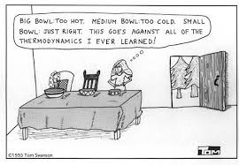
Thermochemistry

Slide 2
What does the prefix thermo mean?
Thermochemistry is the study of the heat associated with a chemical or physical change.
Heat ≠ Temperature
Heat (symbolized by Q or H) is transferable “radiant” energy (enthalpy)
Units – joules (J), kilojoules (kJ), calories (cal)
and kilocalories (kcal) = Calories (Cal) ← Food calories
4.184 J = 1 cal

Slide 3
Heat ≠ Temperature
Temperature (T) – is a measure of the differences in enthalpy between two objects
Units – Degree Celsius or Kelvin
How much Enthalpy (heat) in joules does the combustion of methane release if it releases 45 calories of heat energy?

Slide 4
The relationship between Heat from temperature is muddled:
Depends on what substance… how much substance… and how much energy is available….
Specific Heat Capacity (Cp): The amount of heat required to raise the temperature of 1 gram of substance by 1 degree Celsius
Units: J or cal
g °C g °C
** Specific Heat of water is 4.184 J/g°C or 1 cal/g°C **

Slide 5
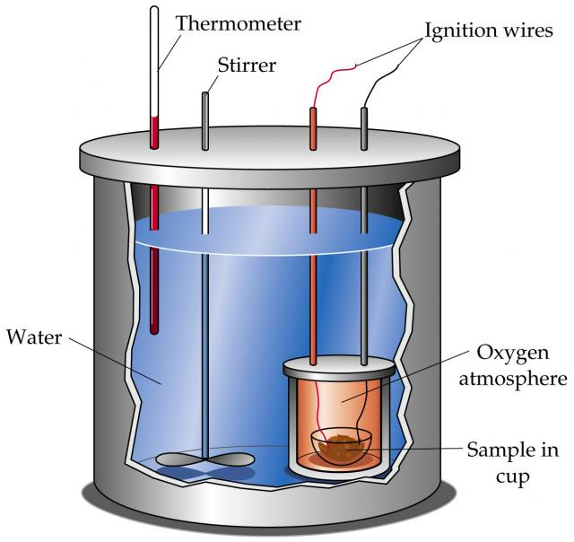
Q is heat change as a result of a temperature change
Calorimeter = tool used to measure
heat changes
Q = mass x change in Celsius temperature x specific heat capacity of the substance
Q = m (Tf – Ti) Cp Q = mCΔT
Example: How much heat is required to raise the temperature of 2.5g of water by 12.5°C?

Slide 6
Complete the following specific heat practice problems in your notebook.
5.0 g of copper was heated from 20°C to 80°C. How much energy was used to heat Cu? (Specific heat capacity of Cu is 0.092 cal/g°C)
How much heat is absorbed by a 20g granite boulder as energy from the sun causes its temperature to change from 10°C to 29°C? (Specific heat capacity of granite is 0.79 J/g°C)
How much heat is released when 30 g of water at 96°C cools to 25°C?

Slide 7
5.0 g of copper was heated from 20°C to 80°C. How much energy was used to heat Cu? (Specific heat capacity of Cu is 0.092 cal/g°C)
Q = mCΔT
= 5.0g (0.092 cal/g°C) (80 – 20)
= 27.6 → 30 cal

Slide 8
How much heat is absorbed by a 20g granite boulder as energy from the sun causes its temperature to change from 10°C to 29°C? (Specific heat capacity of granite is 0.79 J/g°C)
Q = mCΔT
= 20g (0.79 J/g°C) (29-10)
= 300.2 → 300 J

Slide 9
How much heat is released when 30 g of water at 96°C cools to 25°C?
Q = mCΔT
= 30g (4.184 J/g°C) (25-96)
= -8911 → -9000 J

