Slide 4
Practice: Identify as ionic (I) or molecular (M) and calculate the molar mass!
Sulfur Trioxide Hydrogen Phosphate
Carbon Tetrachloride
Iron (II) Sulfate Zinc (I) chloride

Slide 5
Practice: Identify as ionic (I) or molecular (M) and calculate the molar mass!
Sulfur Trioxide (M) SO₃ Hydrogen Phosphate (I) H₃PO₄
S = 32.065 3H = 3(1.0079)
3(O) = 3(16) P = 30.974
80.065 g/mol 4(O) = 4(16) + = 97.998 g/mol
Carbon Tetrachloride (M) CCl₄
C = 12.011 + 4(Cl) = 4(35.453)
= 153.82 g/mol
Iron (II) Sulfate (I) FeSO₄ Zinc (I) chloride (I) ZnCl
Fe = 55.845 Zn = 65.39
S = 32.065 Cl = 35.453
4(O) = 4(16) = 151.91 g/mol = 100.8 g/mol

Slide 6

The Mole
6.02 X 10²³
Notes:
To play the movies and simulations included, view the presentation in Slide Show Mode.

Slide 7
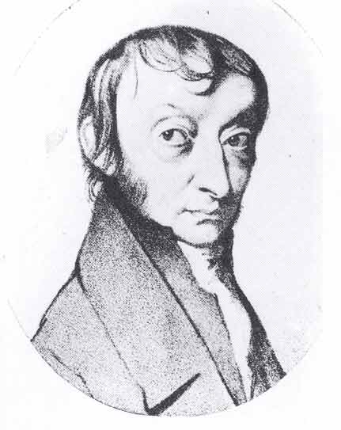
The Mole
A counting unit
Similar to a dozen, except instead of 12, it’s 602 billion trillion 602,000,000,000,000,000,000,000
6.02 X 10²³ (in scientific notation)
This number is named in honor of Amedeo AVOGADRO (1776 – 1856), who studied quantities of gases and discovered that no matter what the gas was, there were the same number of molecules present

Slide 9

Just How Big is a Mole?
Enough soft drink cans to cover the surface of the earth to a depth of over 200 miles.
If you had Avogadro's number of unpopped popcorn kernels, and spread them across the United States of America, the country would be covered in popcorn to a depth of over 9 miles.
If we were able to count atoms at the rate of 10 million per second, it would take about 2 billion years to count the atoms in one mole.

Slide 10
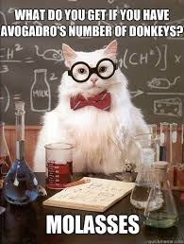
Just How Big is a Mole?

Slide 11
Learning Check
Suppose we invented a new collection unit called a rapp. One rapp contains 8 objects.
1. How many paper clips in 1 rapp?
a) 1 b) 4 c) 8
2. How many oranges in 2.0 rapp?
a) 4 b) 8 c) 16
3. How many rapps contain 40 gummy bears?
a) 5 b) 10 c) 20

Slide 12
The Mole
1 dozen cookies = 12 cookies
1 mole of cookies = 6.02 X 10²³ cookies
1 dozen cars = 12 cars
1 mole of cars = 6.02 X 10²³ cars
1 dozen Al atoms = 12 Al atoms
1 mole of Al atoms = 6.02 X 10²³ atoms
Note that the NUMBER is always the same, but the MASS is very different!
Mole is abbreviated mol

Slide 13
A Mole of Particles
Contains 6.02 x 10²³ particles
= 6.02 x 10²³ C atoms
= 6.02 x 10²³ H₂O molecules
= 6.02 x 10²³ NaCl “molecules”
1 mole C
1 mole H₂O
1 mole NaCl

