Slide 1
Dimensional Analysis

Slide 2
What’s the Rule?

Slide 3
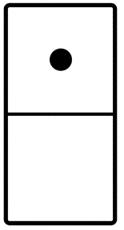
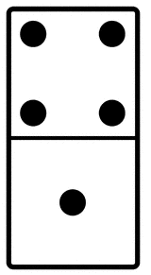
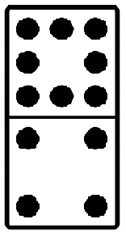
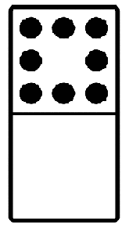
What’s the Rule?

Slide 4
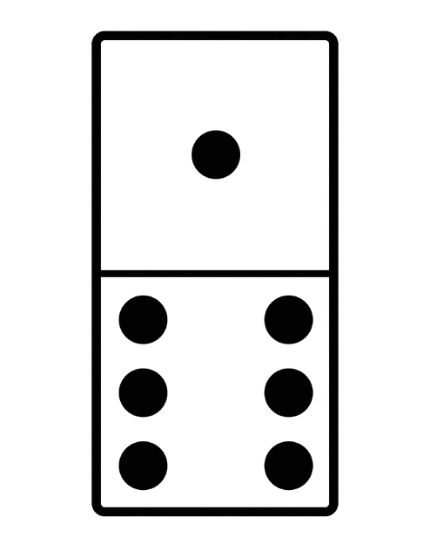
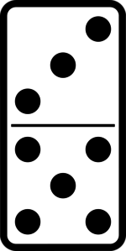
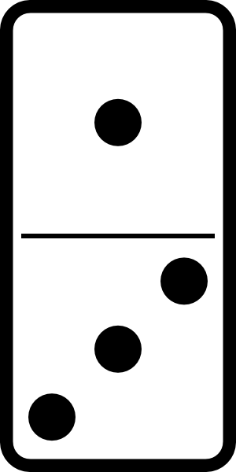
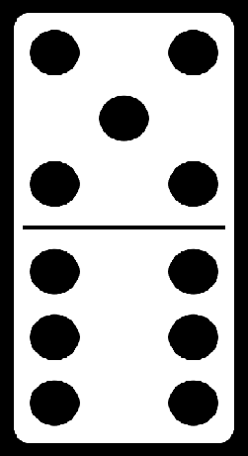
What’s the Rule?

Slide 5
Unit Conversion Factor
A fraction whose numerator and denominator are equivalent (you can also use the reciprocal)

Slide 6
To solve a dimensional analysis problem you want to choose a unit conversion factor that…
Introduces the unit you want in the answer
Cancels out the original unit so that the one you want is all that is left.

Slide 7
“Canceling out” Words

Slide 8
Practice: Choose the appropriate conversion factor.
Inches to feet
Minutes to hours
Meters to centimeters

Slide 9
Metric Conversions
Prefix | Abbrev | Factor = 1 base unit
Mega- | M | (0.0000001) 10⁻⁶
kilo- | k | (0.001) 10⁻³
hecto- | h | (0.01) 10⁻²
BASE UNIT | g, L, m | 1
deci- | d | 10¹
centi- | c | 10²
milli- | m | 10³
micro- | µ | (1000000) 10⁶
nano- | n | (1000000000) 10⁹
pico- | p | (1000000000000) 10¹²

Slide 10
Examples
One bag of apples weighs 64 ounces. How many pounds does it weigh?
Darren drank 2 liters of water. How many milliliters of water did he drink?

Slide 11
Convert 80 miles per hour to feet per hour.
Convert 63,360 feet per hour to miles per hour.

Slide 12
D.A. Activity #1
Practice in your notebook
1. Convert 38 cm to m 2. Convert 417 mg to g 3. Convert 80 m to km 4. Convert 0.0025L to nL 5. Convert 0.17 m to mm

Slide 13
D.A. Activity #1 Answers
1. 0.38 m 2. 0.417 g 3. 0.030 km 4. 2,500,000 nL 5. 170 mm

Slide 14
D.A. Activity #2
Convert 97.0 miles to km.
Convert 86 µL to L.
Convert 980 cm to Mm.

Slide 15
1. Convert 97.0 miles to km.
97.0 mi 1.609 km = 156.073 → 156 km
1 mi

Slide 16
2. Convert 86 µL to L.
86 µL 1 L = 0.000086 L
10⁶ µL

Slide 17
3. Convert 980 cm to Mm. whatttttt
980 cm 1 m 10⁻⁶ Mm = 0.0000098 Mm
10² cm 1 m
980 cm 10⁻⁶ Mm = 0.0000098 Mm
10² cm

Slide 18
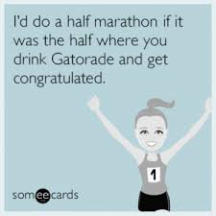
A little bit harder now…
Sheila ran a half-marathon (13.1 miles). She wants to know how many centimeters she ran.

Slide 19
Convert 13.1 miles to cm.
13.1 mi 1.609 km 1 m 10² cm = 2110000 cm 1 mi 10⁻³ km 1 m

Slide 20
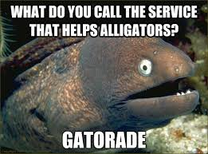
Mark drank 7.6 ounces of gatorade. He wants to know how many nanoliters he drank. (there are 128 oz in one gallon).

Slide 21
Convert 7.6 ounces to nL.
7.6 oz 1 gal 1 L 10⁹ nL = 2.2 x 10⁸ nL 128 oz 0.264 gal 1 L

